Slide 1

In this together.
National Reconciliation Week 2020
A conversation guide

Slide 2
Heading
About this conversation guide
Sub heading
This guide has been prepared for teams and individuals to reflect on the significance of National Reconciliation Week 2020 for Transport, our own commitment to reconciliation, and to identify specific actions that you can take to contribute to reconciliation.
Resources to assist you in preparing for and having a good conversation:
National Reconciliation 2020 Transport webisode (watch it live at 10am on Wednesday 27 May or any time afterwards as catch-up)
Guidelines to Delivering an Acknowledgement of Country online
Our Reconciliation Action Plan
Aboriginal Procurement Policy
Suggested time for the conversation: 1 hour

Slide 3
Acknowledgement of Country

Slide 4
Webisode highlights
What did we think and what did we learn?

Slide 5
Heading
Webisode
Sub heading
Let’s revisit the highlights – what did we think and what we learn?
Keynote address from Ray Martin AM
The update on our Reconciliation Plan 2019 - 2021
a conversation with Elizabeth Mildwater and Fiona McLean
Implementing our RAP
a conversation with Elizabeth Mildwater and Rebecca Hyland

Slide 6
Our reconciliation action plan
3 focus areas and 15 key commitments

Slide 7
Our vision for Reconciliation
Where respect, collaboration and partnership foster greater inclusion, recognition and celebration for our Aboriginal and Torres Strait Islander peoples across all segments of NSW’s vibrant community.

Slide 8
Heading
Our commitment
Sub heading
Our Reconciliation Action Plan sets out our commitments in the following areas:
Relationships
Establish and maintain mutually beneficial relationships with Aboriginal and Torres Strait Islander stakeholders and organisations
Build relationships through celebrating National Reconciliation Week
Promote reconciliation through our sphere of influence
Promote positive race relations through anti-discrimination strategies
Respect
Increase understanding, value and recognition of Aboriginal and Torres Strait Islander cultures, histories, knowledge and right through cultural learning
Demonstrate respect to Aboriginal and Torres Strait Islander peoples by observing cultural protocols
Build respect for Aboriginal and Torres Strait Islander cultures and histories by celebrating NAIDOC Week
Opportunities
Improve employment outcomes by increasing Aboriginal and Torres Strait Islander recruitment, retention and professional development
Increase Aboriginal and Torres Strait Islander supplier diversity to support improved economic and social outcomes
Promote respect for Aboriginal heritage and increase inclusion of Aboriginal art
Embed Aboriginal and Torres Strait Islander co-design principles across Transport cluster projects
Governance
12. Establish and maintain an
effective Reconciliation Advisory
Committee (RAC) to drive
governance of the RAP.
13. Provide appropriate
support for effective
implementation of RAP
commitments.
14. Build accountability and transparency through reporting
RAP achievements, challenges and learnings both internally and externally.
15. Continue our
reconciliation journey by
developing our next RAP

Slide 9
Actions we can take
What can we do - as a team, or as individuals - to contribute to reconciliation?

Slide 10
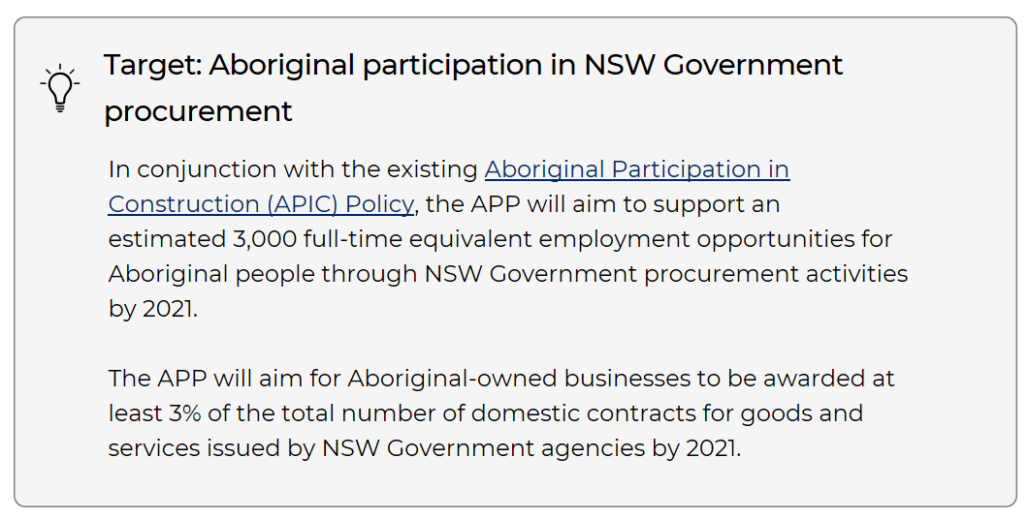
Heading
Aboriginal Procurement Policy
Sub heading
RAP Action 9 - Increase Aboriginal and Torres Strait Islander supplier diversity to support improved economic and social outcomes.
Source: Aboriginal Procurement Policy

Slide 11


Heading
Aboriginal Procurement Policy continued
Sub heading
An agency may purchase goods and services valued up to $250,000 excluding GST, from an Aboriginal owned business after receiving a single quote provided that value for money and quality of goods and services can be demonstrated (Source: Aboriginal Procurement Policy 3.2.1)
There are many excellent Aboriginal businesses, services suppliers and contractors working across NSW
You can search or inquire about Aboriginal suppliers:
Supply Nation supplynation.org.au
NSW Indigenous Chamber of Commerce nswicc.com.au

Slide 12
Heading
Actions we can take
Sub heading
What can we do?
What does reconciliation mean to you?
How can our team collaborate and contribute with Aboriginal communities for greater outcomes in the work we do?
How could we be more proactive with sourcing and working with Aboriginal suppliers?
What else could we do to contribute reconciliation?

Slide 13
Next steps
Sub heading
Record any specific actions we decide to take
What | Who | When

Slide 14
Thank you

