Slide 1
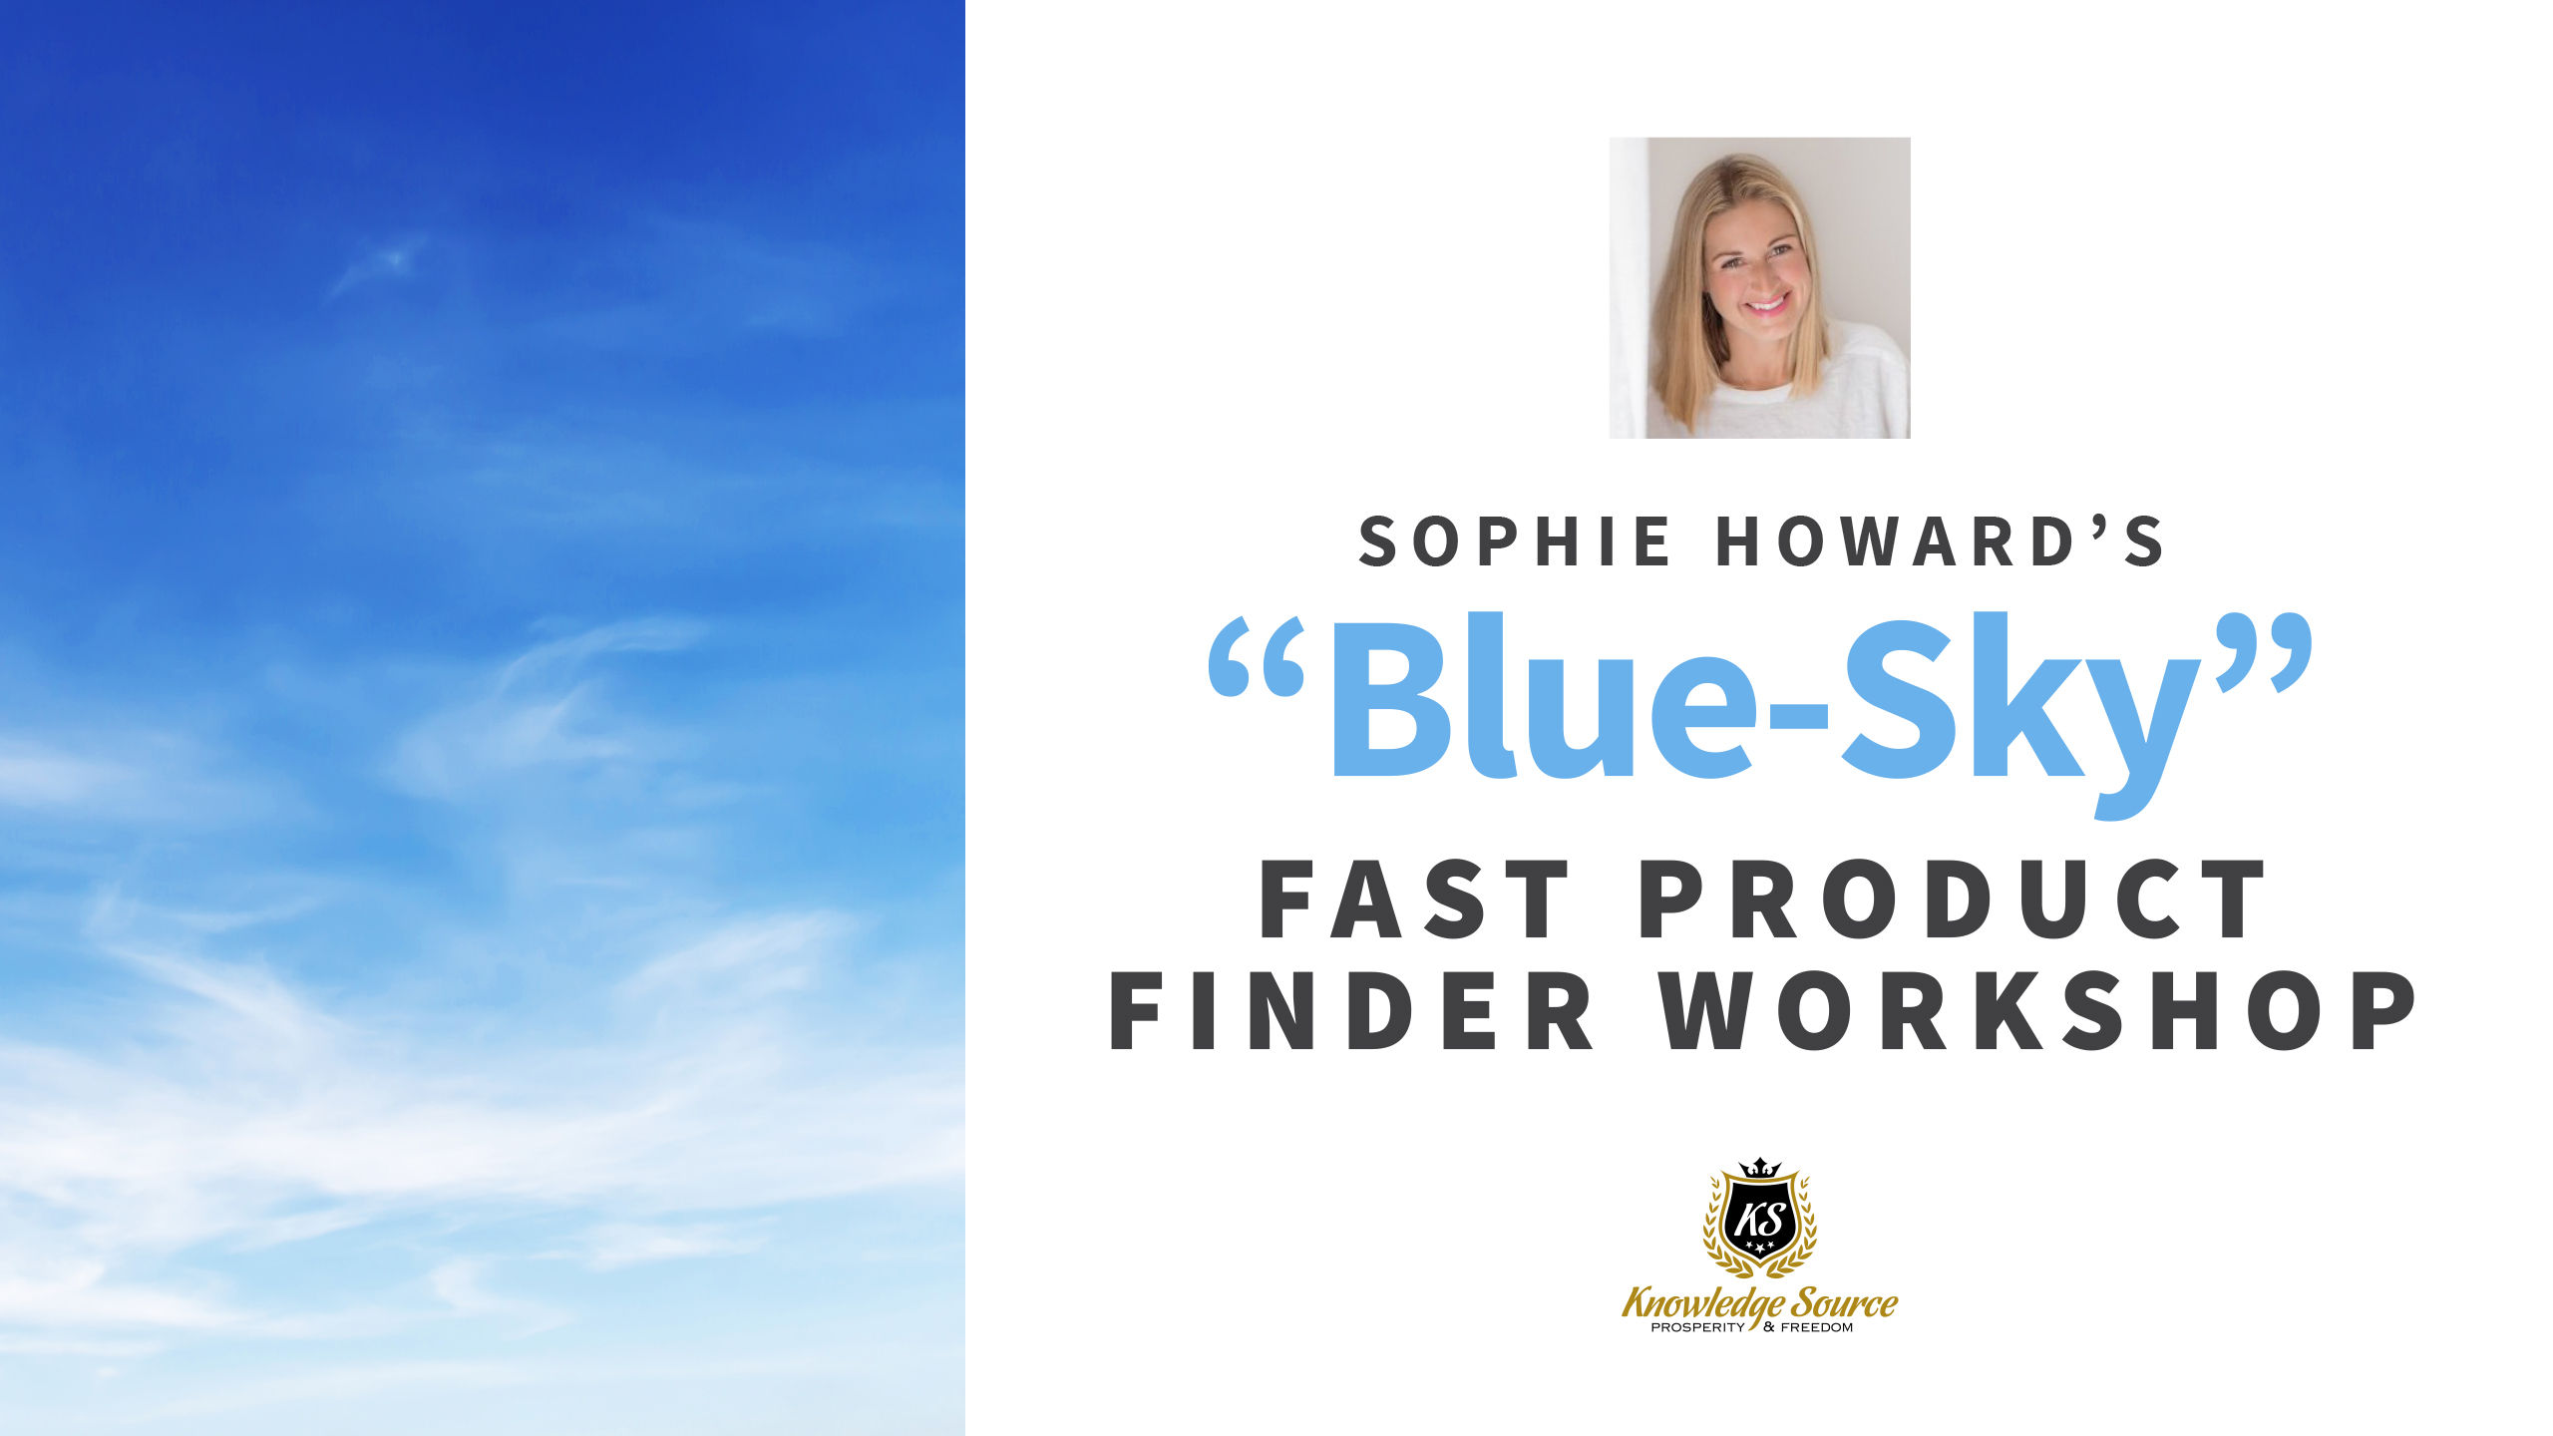

Slide 2
Welcome to the
Fast Product Finder
Workshop
Notes:
Preframe
Trust factor
Audience interaction
Questions
Breaks 10.30 – 10.45
Lunch 1.20 – 2.20
3.30-3.45

Slide 3
Workshop Timetable
Amazon Strategy
10 Best Product Niches ….. And why
How to Come up with Ideas
Product Assessment (demand, competition, profits, X-Factor)
Live Product Demos
Points of Difference

Slide 4
Sophie’s Amazon Strategy
Private Label
Low Competition Niches only
Go for Premium Pricing and Products if You Can
Build a Brand
Build to with the Intention to Sell
Low Key Launches - Minimum Viable Brand
Small Initial Orders - Minimum Viable Brand
Source Where No-one else is Looking
Be Hard to Copy

Slide 5
Your Amazon Business
What is the intention for your Amazon business?
Why your intention helps you find the right products to sell
What if you’re not sure what you want from your business yet?
Who would want this product and how does it makes them feel?
Notes:
Can you shout loud and proud about your new biz venture?

Slide 6
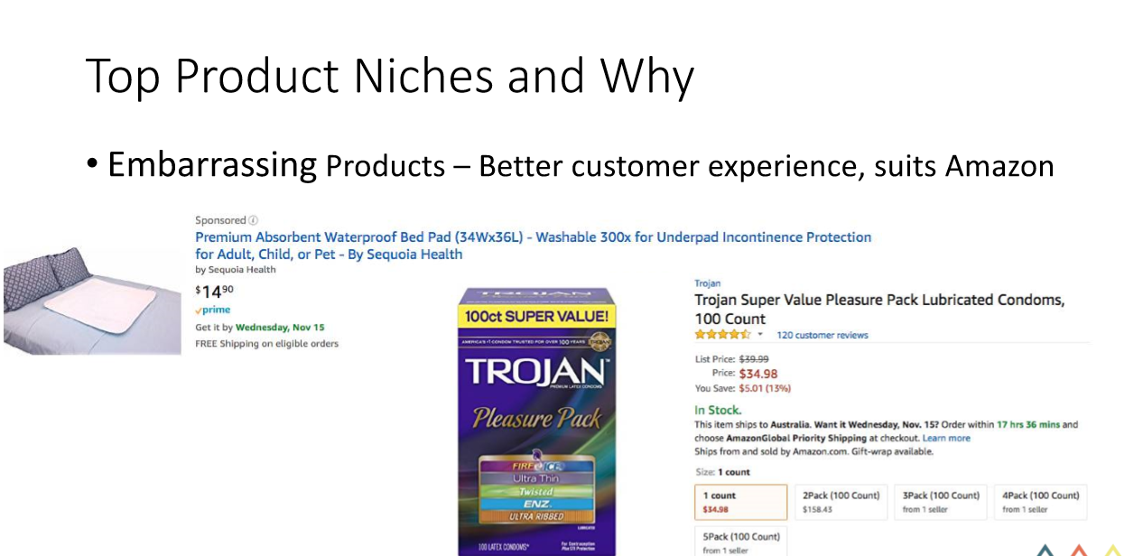
Notes:
Preface that these are not products you would actually do

Slide 7


Top Product Niches and Why
Home Décor – High perceived value and many products avaiable

Slide 8
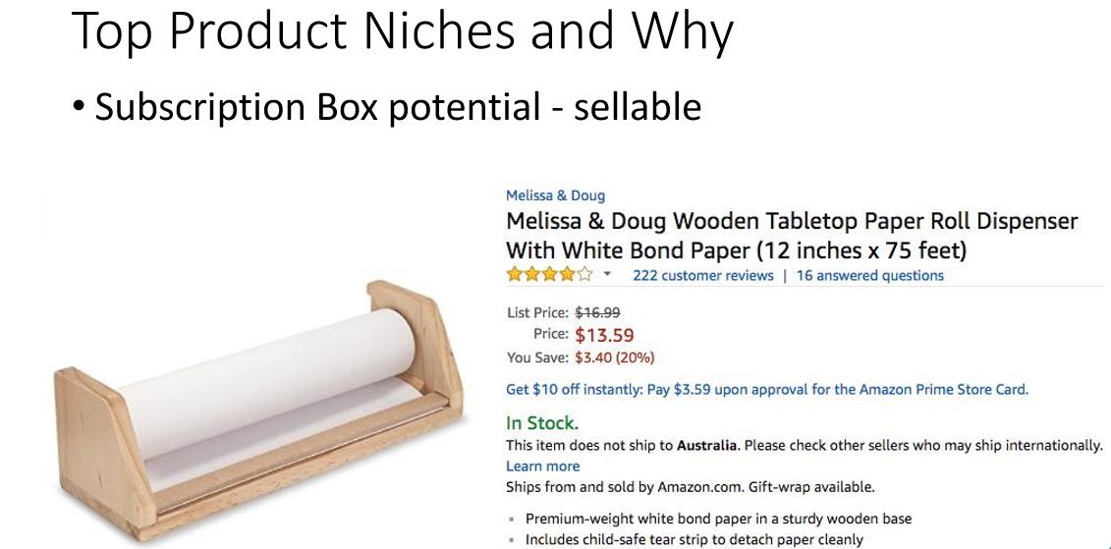
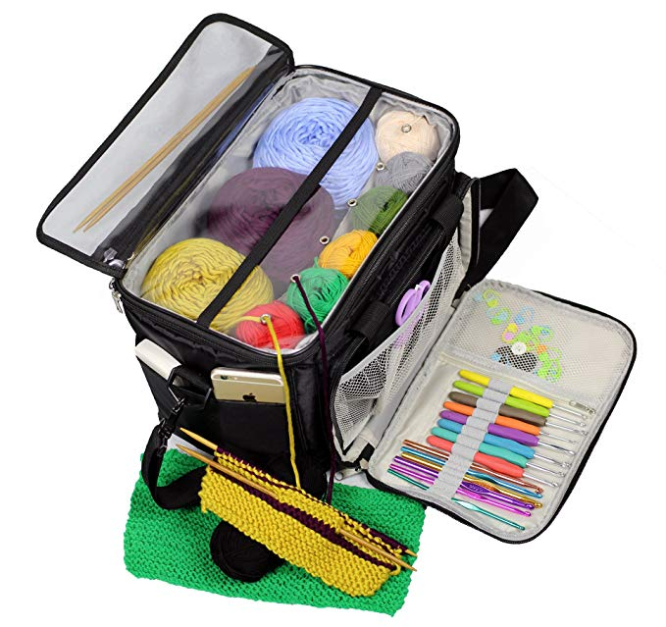


Slide 9
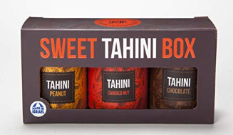
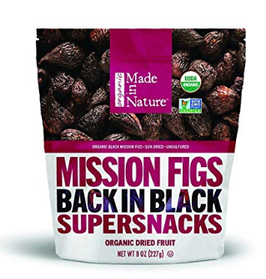
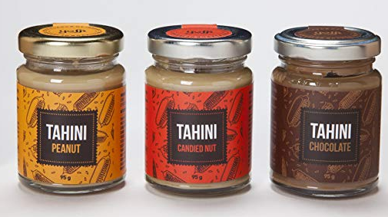
Top Product Niches and Why
Boutique foods – Subscription potential

Slide 10
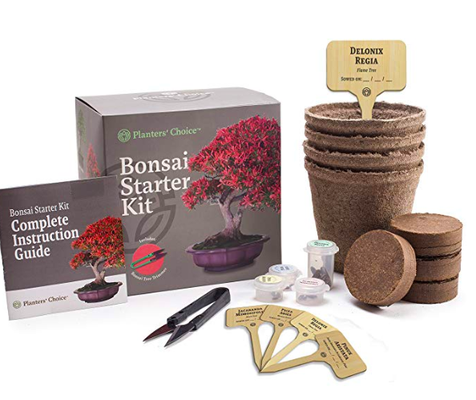
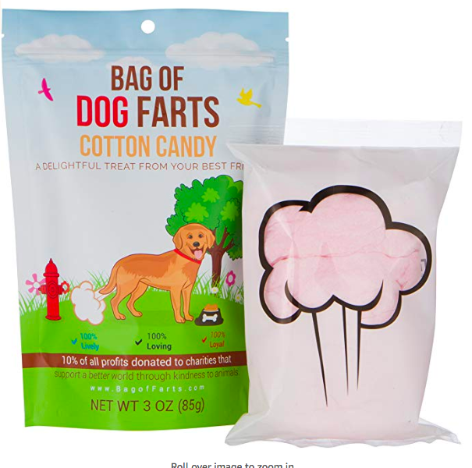
Top Product Niches and Why
Small and Light

Slide 11
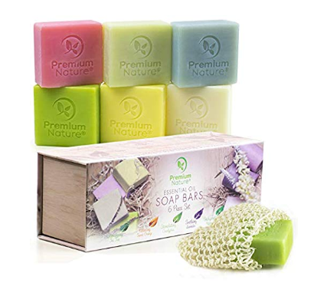
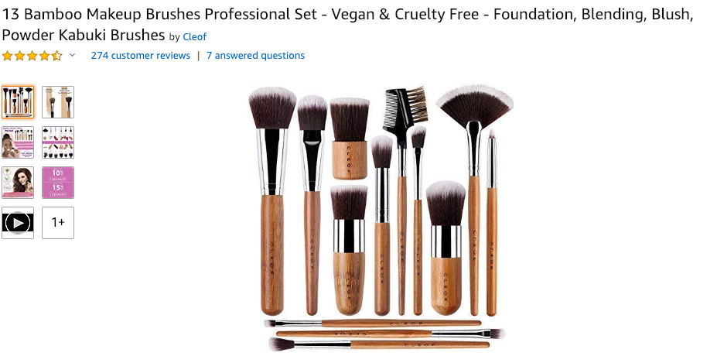
Top Product Niches and Why
Vegan Products – High perceived value and a wealthy demographic

Slide 12
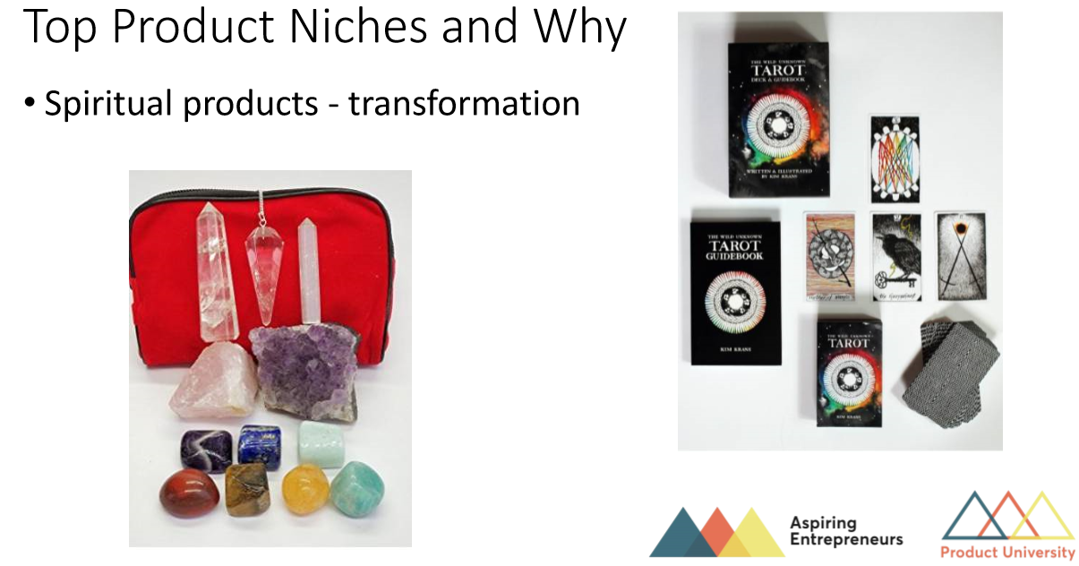

Slide 13
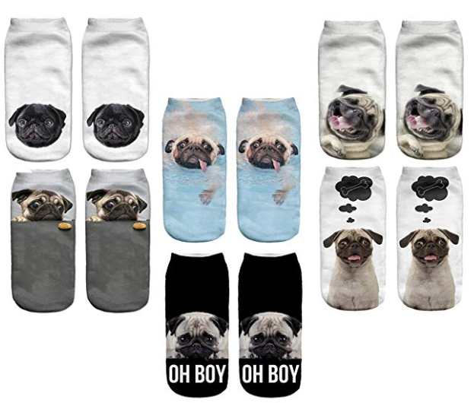

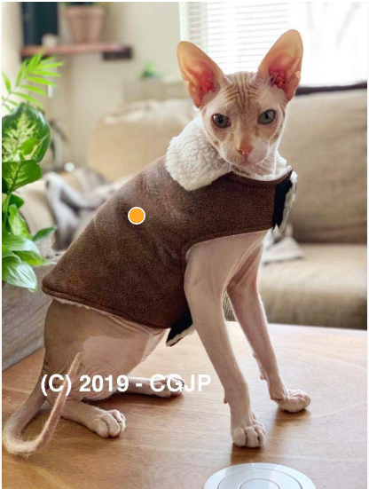
Top Product Niches and Why
Pet Products – irrational spending

Slide 14
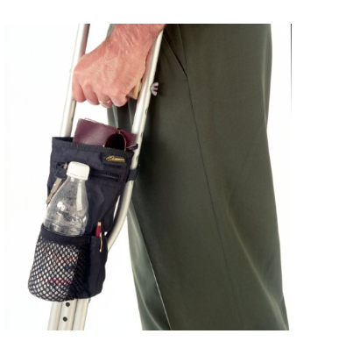
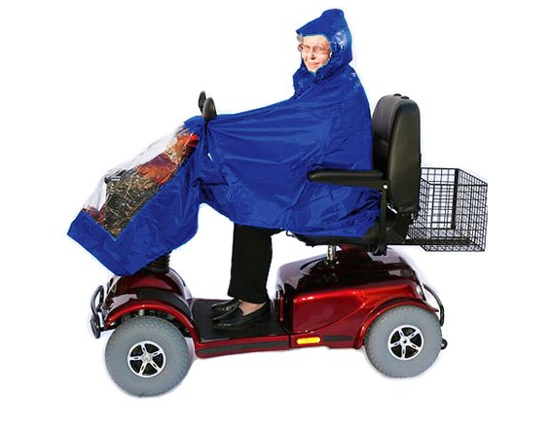
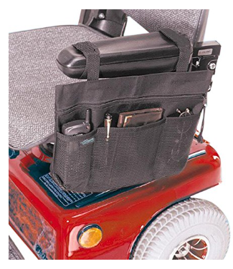
Top Product Niches and Why
Granny products – newest demographic online

Slide 15
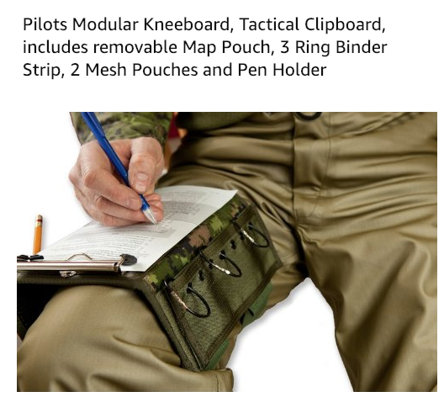
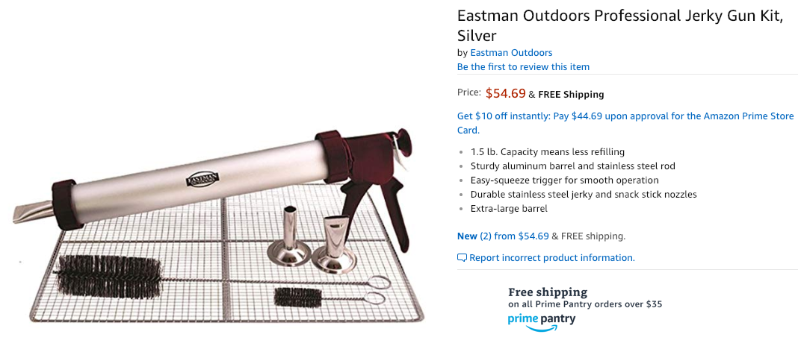
Top Product Niches and Why
Expensive hobbies

Slide 16
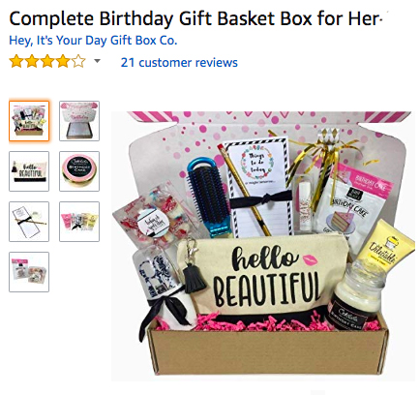

Top Product Niches and Why
Gifts for women – men are always looking for something easy to send!

Slide 17
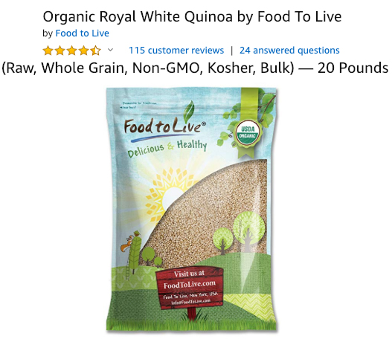
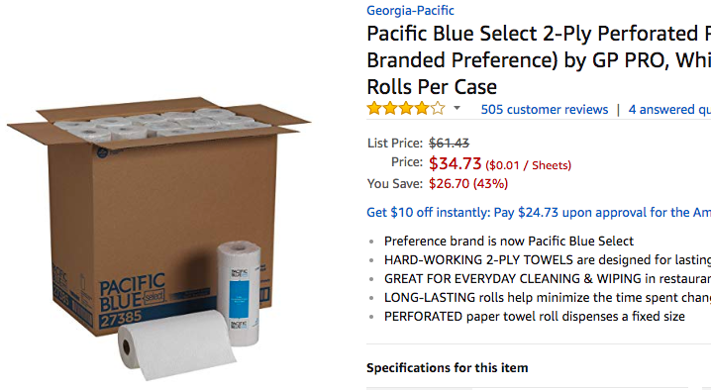
Top Product Niches and Why
Bulky and boring products
Notes:
Business to business idea too

Slide 18
Now We Know the Best Niches
How Do We Find the Best Products to Choose?

Slide 19
Physical Features
No electronics
Size (to a point)
Consumables
Margins/ premium pricing
Not fragile if possible
Doesn’t require FDA or medical approval
Not seasonal or fad items
No high liability or risk
Anything already patented or trademarked
Known brands

Slide 20
Top Techniques for Great Product Hunting
Amazon catalogue
Trade Show websites
Something you’ve bought recently
Something you know about
Scan Sophie’s top tips categories/niches

Slide 21
Top Techniques for Great Product Hunting
In airports
Pharmacies
Catalogues
Magazines
In your home town – markets, boutique shops, local artisans
Agricultural shows
Local Trade Shows

Slide 22
Assessing Competition and Demand
1. Search past page one on Amazon
2. Look for a gap in relevancy of returned search results
3. Check if anyone is making money – jungle scout

Slide 23
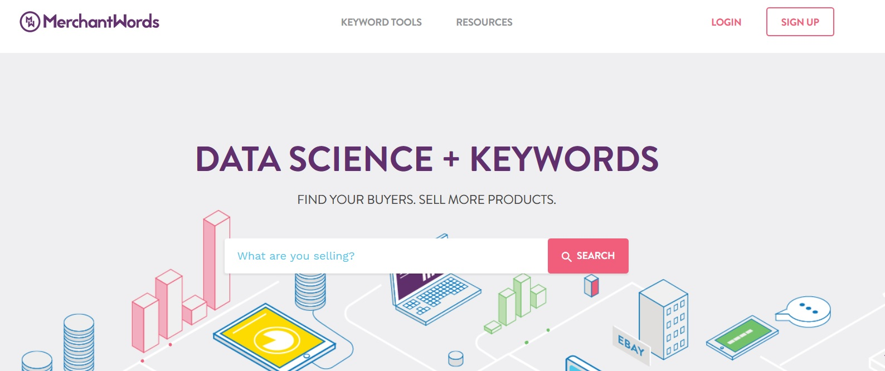
Assessing demand – Merchant words

Slide 24
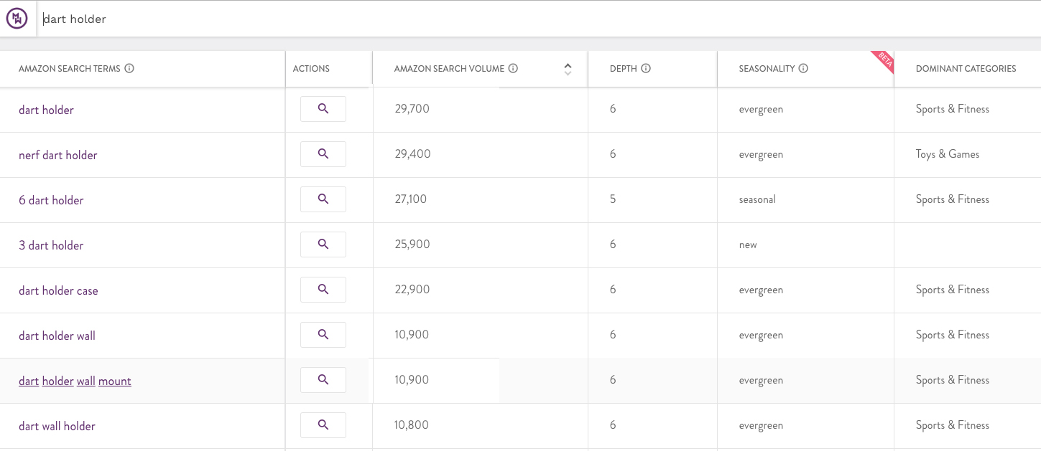
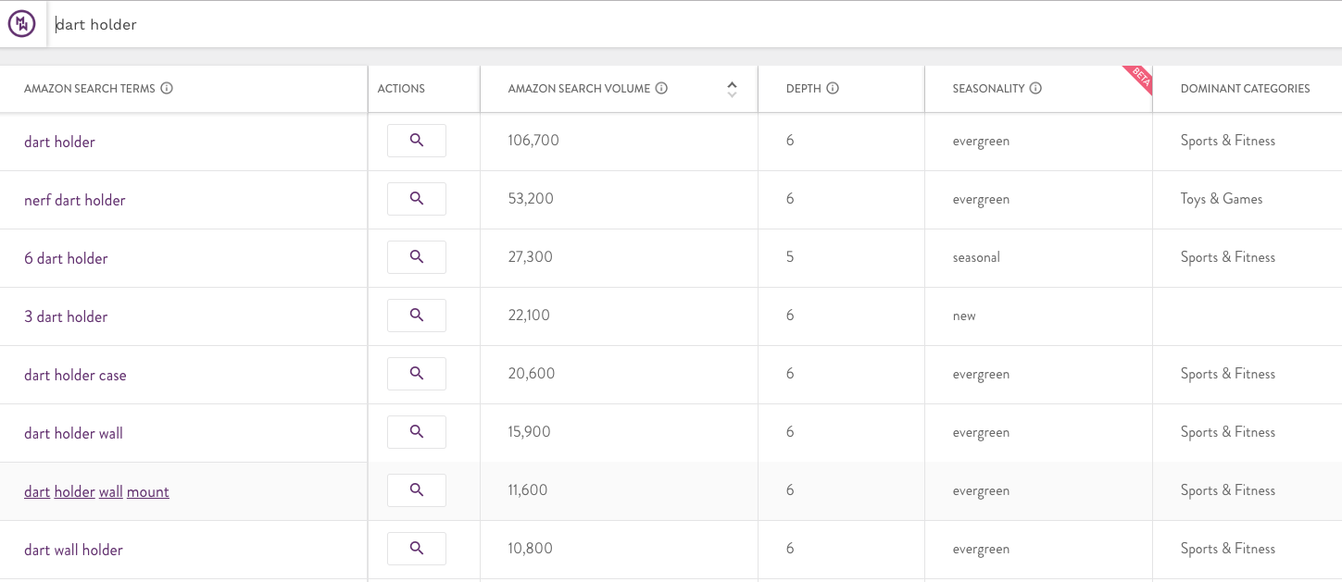
Guide for picking in demand product
Notes:
Seen this as low as 30K

Slide 25
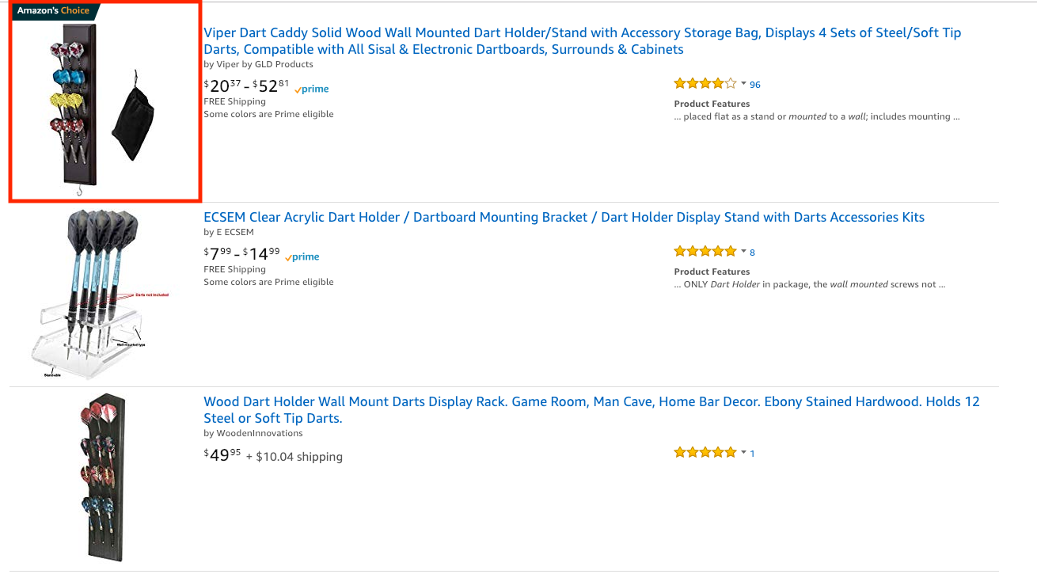
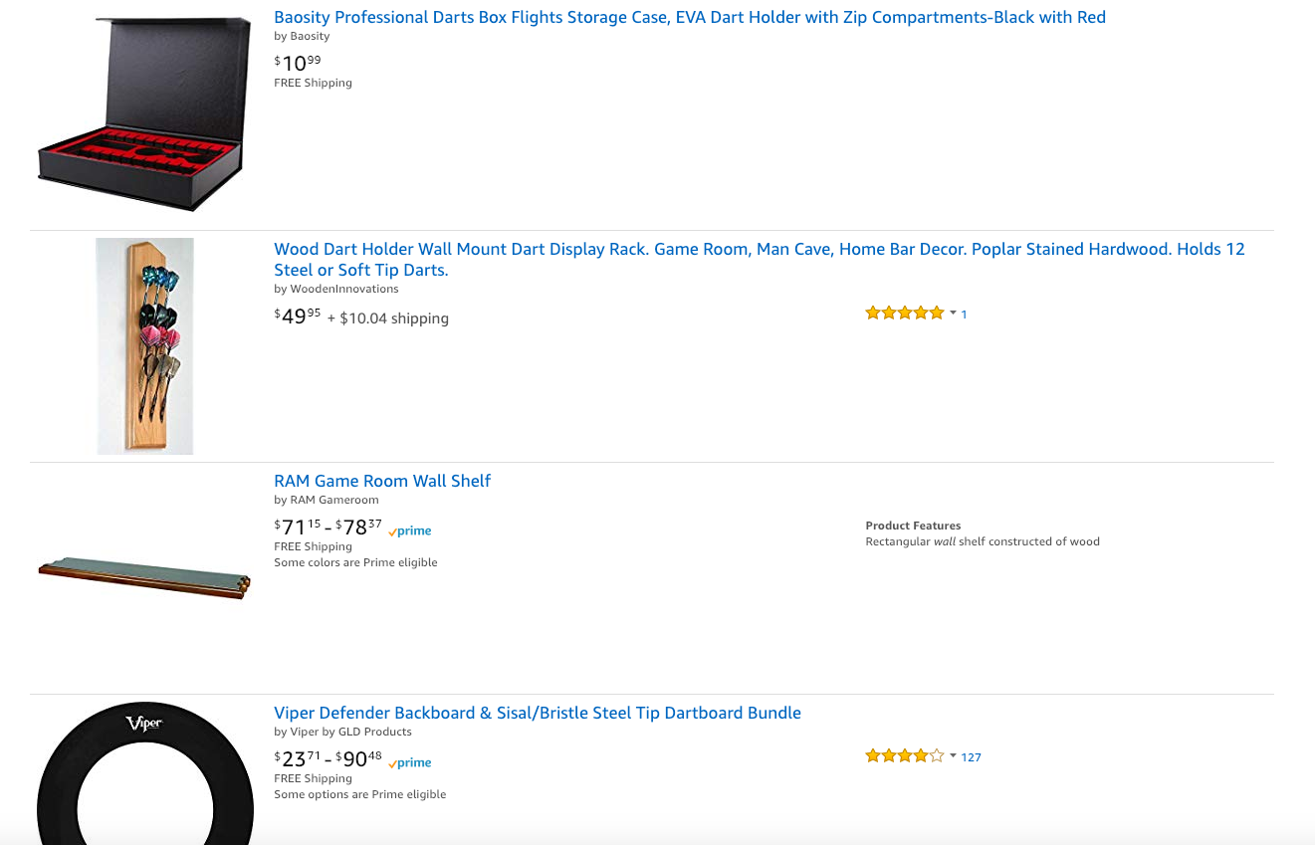
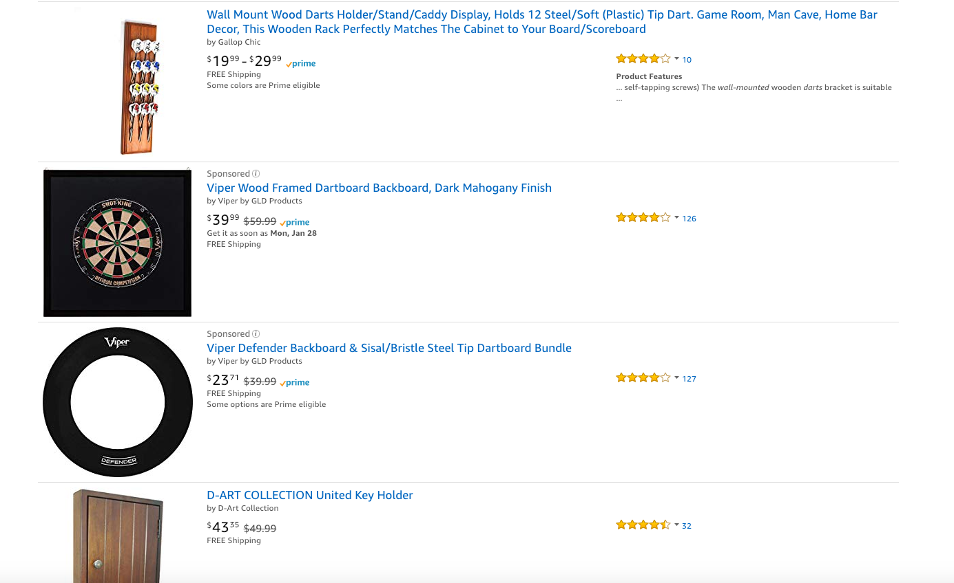
Assessing competition – Amazon search

Slide 26
Rating the competition - Relevance
Where is it estimated to land;
Within the first 5 listings
First page
Second page

Slide 27
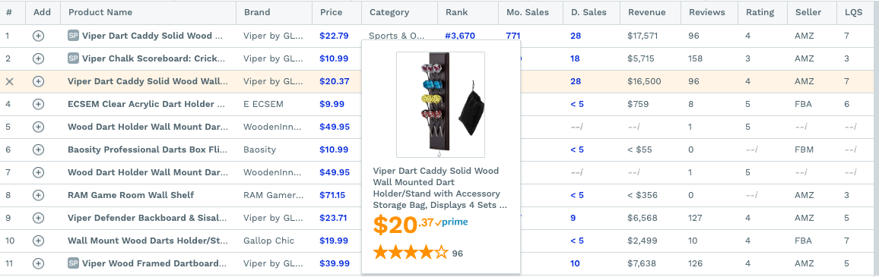
Is anyone making money here?

Slide 28
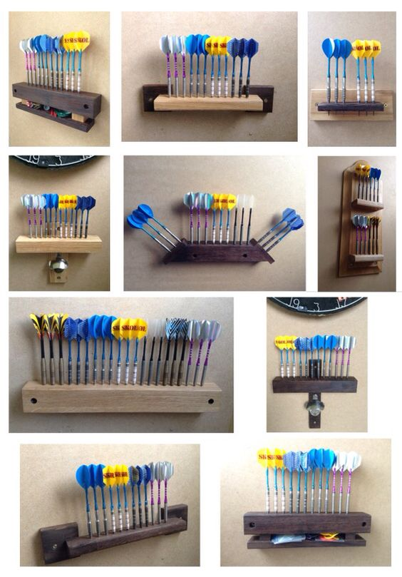
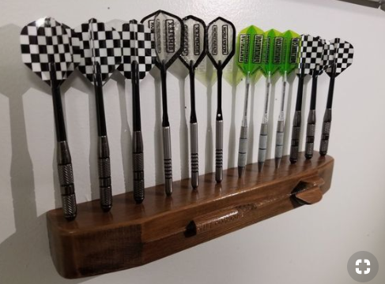
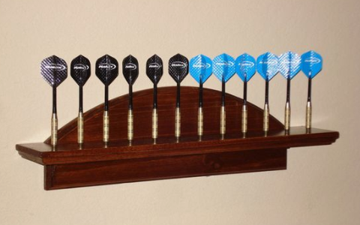
Could you do something a little differently?
Shape, colour, functionality, bundling

Slide 29
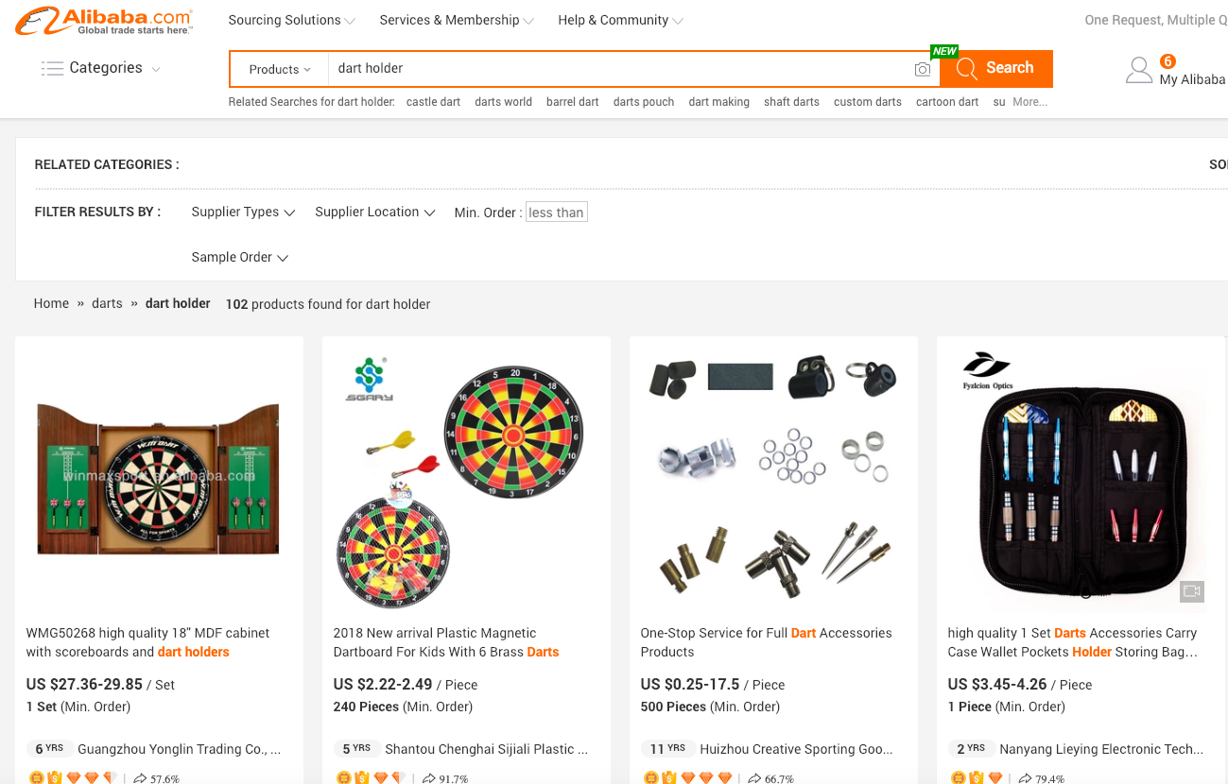
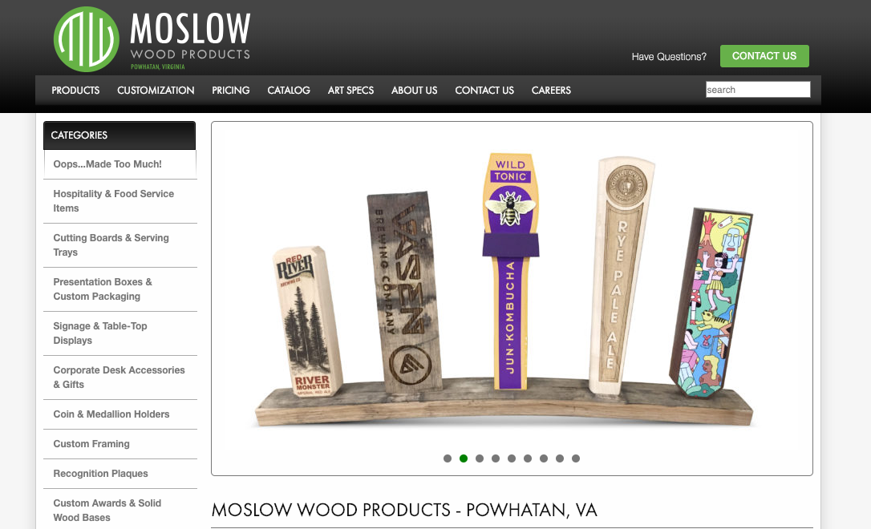
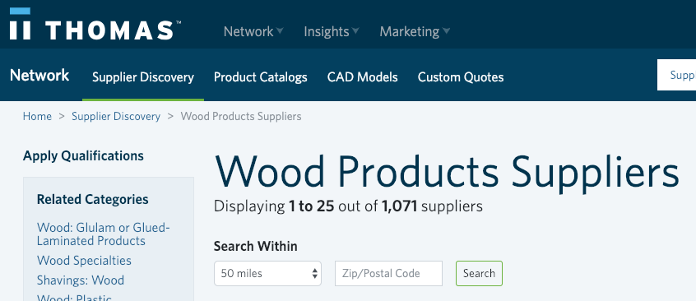
Suppliers

Slide 30
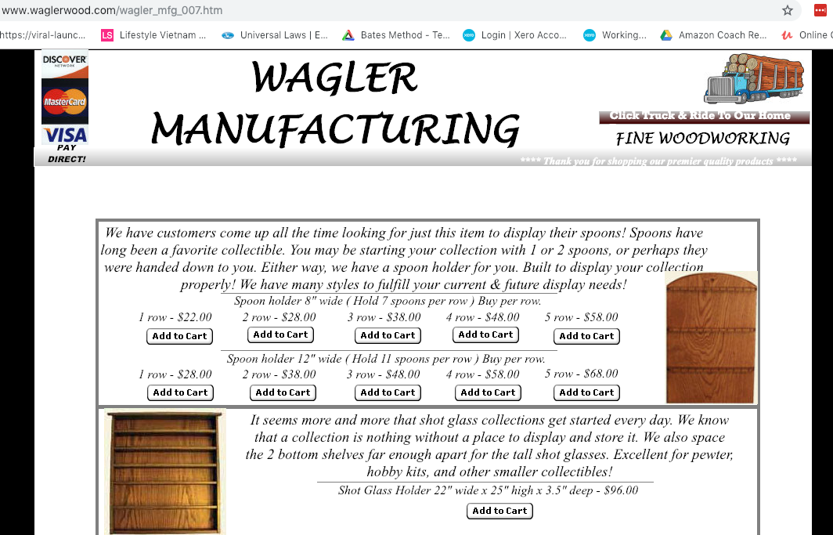

Suppliers

Slide 31
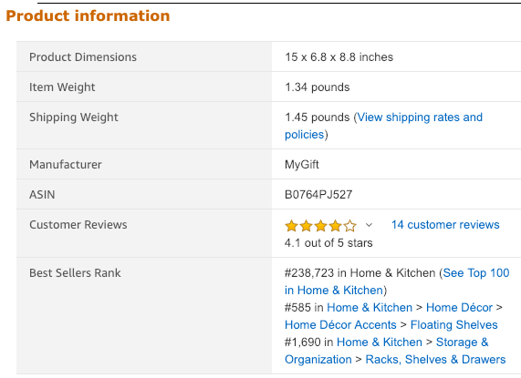
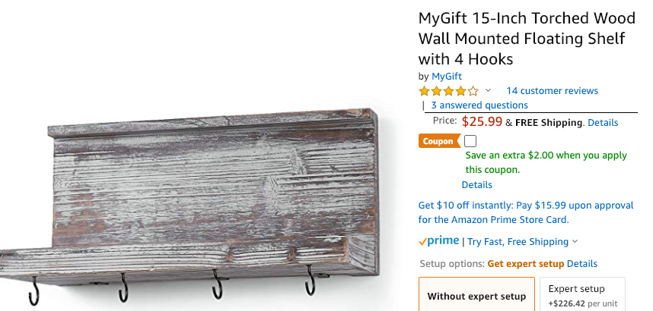
Margins

Slide 32
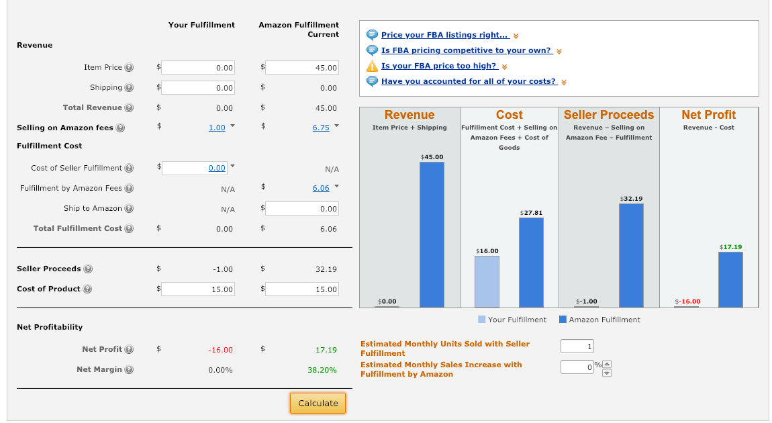
Margins
Margin more than 40% - Awesome
30% - Good
20% - OK

Slide 33
X Factor 10 Points
Private label opportunities
Knowledge of the product
Any value we can add to put us ahead of the competition
Any improvement we can make?
What are the competitors photos like?
Are the listings well described?
What are the reviews like?
Can you list with variations of size?
Can we compete?

Slide 34
How do we rate the dart holder opportunity?

Slide 35
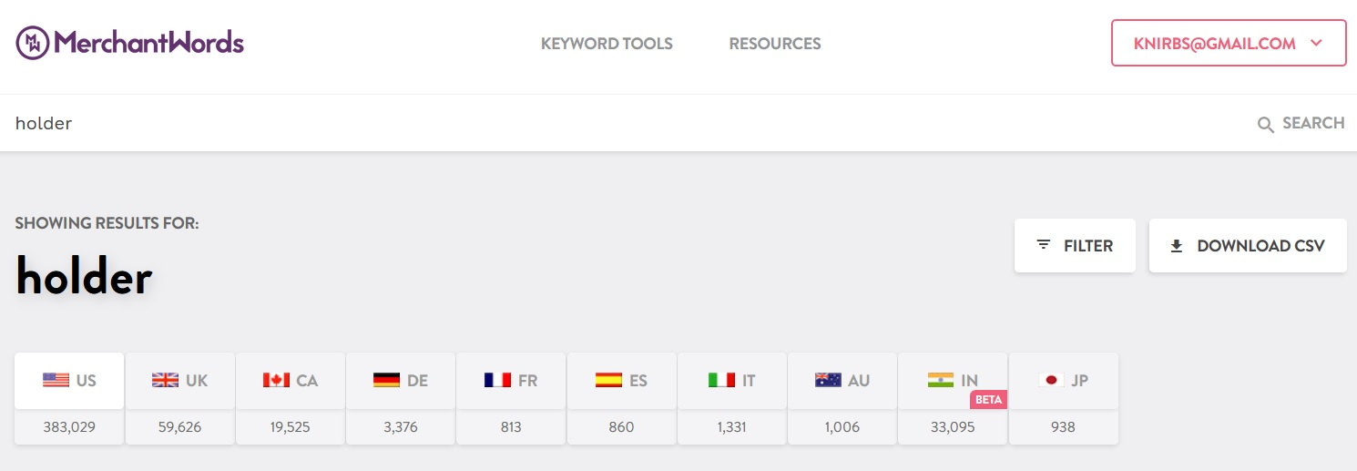
Coming up with product ideas quickly and easily through Merchant words.

Slide 36
Great keywords to get you started
Caddy
Organizer
Holder
Garden
Bathroom
Kitchen
Stand
Party
Knitting
Sailing
Cooking
Baking
Bamboo
Eco friendly
Reusable
Green friendly
Vegan
Bulk
Kit
Rustic
Wall Mounted
Bronze
Copper

Slide 37
Step 1. Put a word into Merchant words

Slide 38
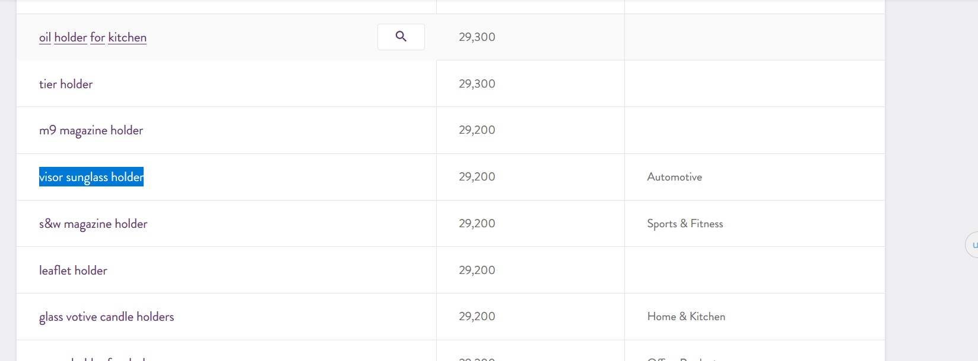
Scroll down to 30-60k searches per month

Slide 39
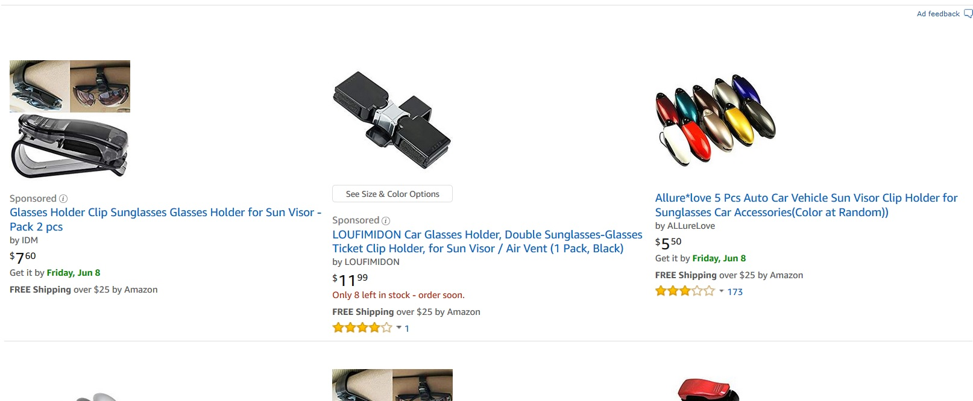
Start picking interesting products and comparing with amazon search results

Slide 40
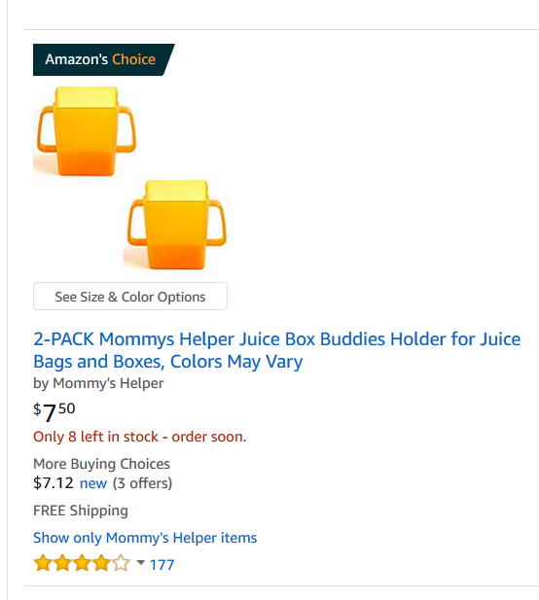
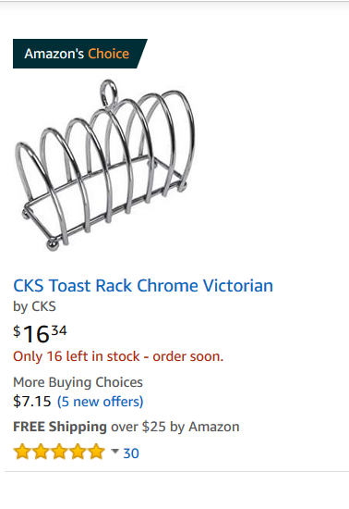
Shortlist all the products that could potentially rank well on page one due to relevance.
Toast holder
Wall wine holder
Juice box holder
Key chain pill holder
ETC

Slide 41
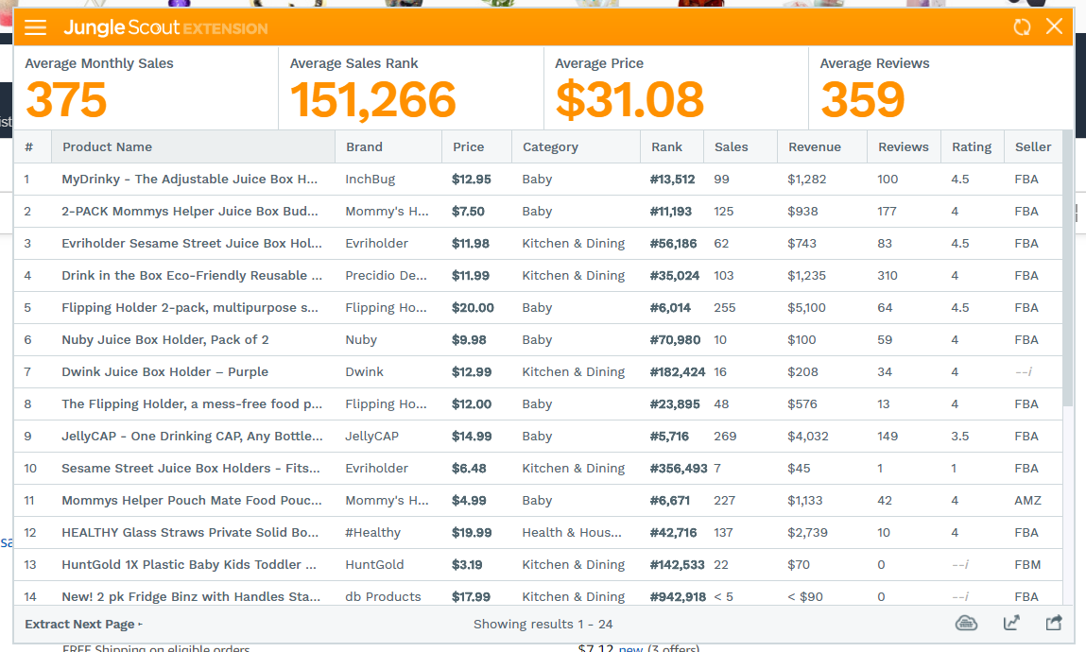
Come back to your shortlist and confirm the search term/category is making money

Slide 42
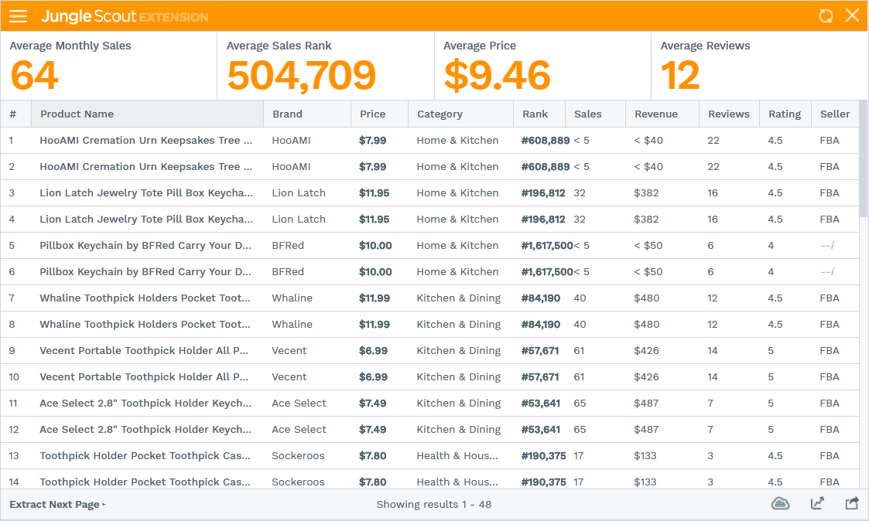
Cross off items that simply aren’t making money
Toast holder
Wall wine holder
Juice box holder
Key chain pill holder
ETC

Slide 43
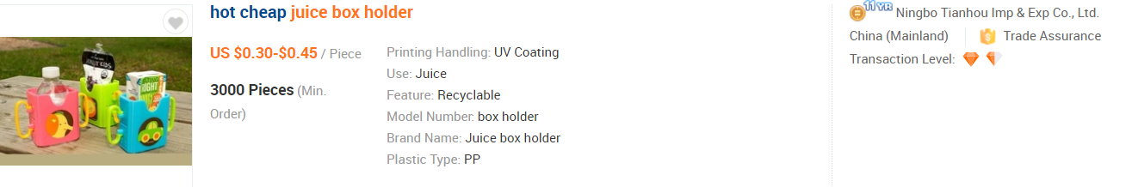
Start looking for suppliers for your shortlist to obtain potential net profit.

Slide 44
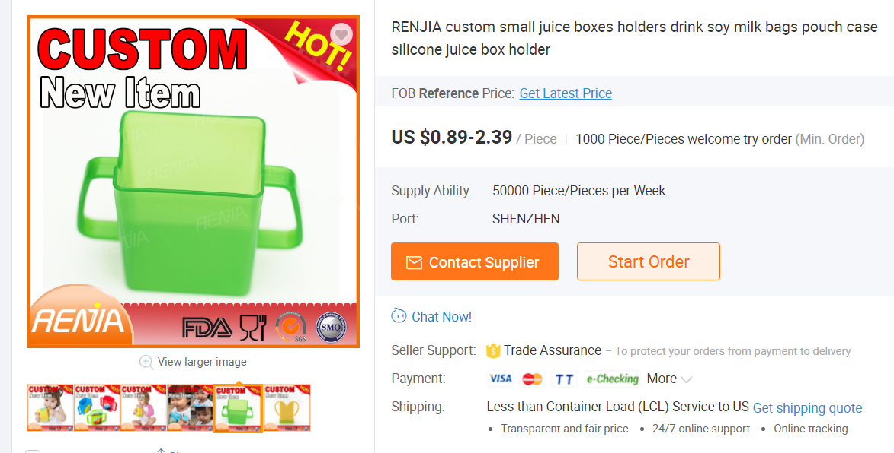
Pick the best and consider an order…..

Slide 45
Q & A
Notes:
Check google trends, pinterest, who’s doing this already, facebook, instagram

Slide 46
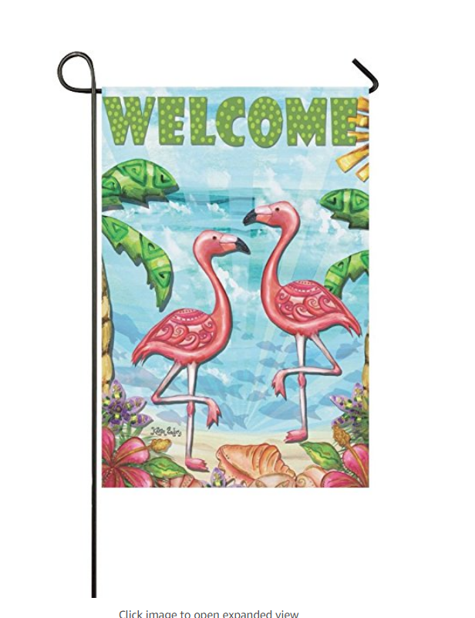

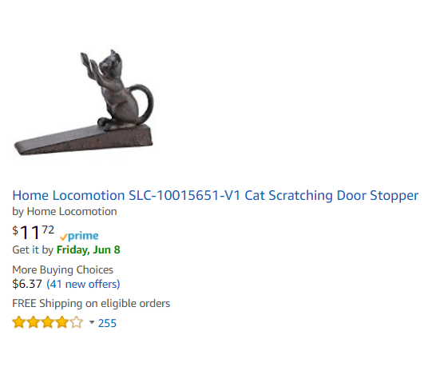
Keyword Mash
A killer strategy to cut through to page one in a competitive niche
Notes:
Garden flags
Owl coffee mug
cat door stopper

Slide 47



What’s the keywords?
Notes:
All found at trade shows

Slide 48


What’s the keywords?
Notes:
Tibetan singing bowl (set), brass singing bowl. Men’s dresser tray, valet tray, leather valet tray

Slide 49



What’s the keywords?
Notes:
Hanging bird feeder, ceramic hanging candle holder, hand-painted ceramic . Wall hook, ceramic wall hook, coat hook, hand painted, wrought iron. Kids wall animal heads, felt

Slide 50
Worked Examples

Slide 51


How to check for listing limitations such as ungating requirements
Grab the ASIN of the product that is similar to yours in the same category
In seller central - add new product

Slide 52


How to check for listing limitations such as ungating requirements
Click the listing limitations apply link above
Yes you will need to be approved for this section of Amazon

Slide 53
Create Build and Scale
Create
Product
Account
Brand
Build
Business Systems
Business team
Supply Chain
Scale:
Expand your product line
Expand your team
Expand your supply chain
Notes:
Scaling
Why Scale
Lifestyle vs Growth
Smart Work vs Hard Work
Planning
Measuring
Profiting

Slide 54
Daily Checklists
Daily Checks
Listings are live
Messages – respond within 24 hours (develop your own FAQs)
Sales look ‘normal’
New product research

Slide 55
Weekly Checklists
Weekly Checklists
Inventory, Reorder if needed (check cash flow)
Team check in
Amazon key reports – Conversion rate, Sales and Traffic
Supplier check in
Batch any payments
Make decisions based on new product research
Plan launches
Check PPC ads
Track any shipments and follow up if needed

Slide 56
Monthly Checklists
Inventory – Do stock take
Bookkeeping
Profit and Loss
Cash Flow
Budget for new products
Assess portfolio
Place new product orders
Create launch plans
Learning and Development plan- reading, podcasts, courses etc

Slide 57

People we’ve used and recommend
Copywriting: Fastadking on Fiverr
Websites: Harin D on Upwork
Labels and package design: Marcin Reguki on Upwork
White background creation: Mostafakamal007 on Fiverr
Amazon Seller App for Photos

