Slide 1
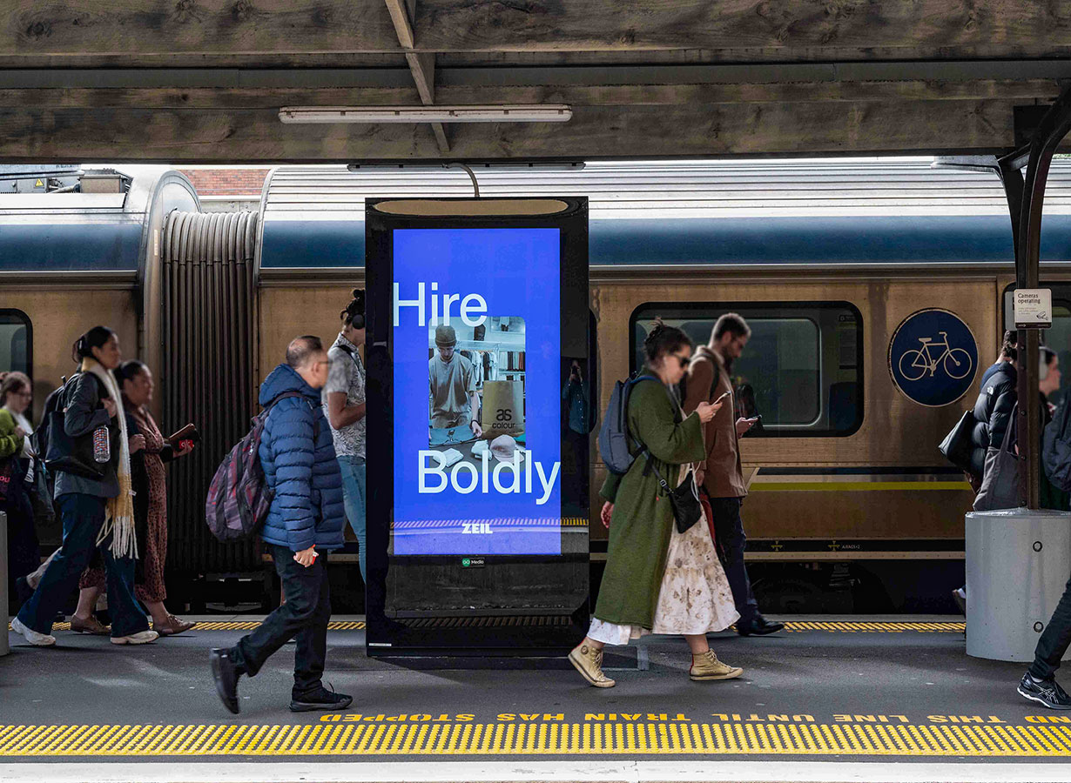
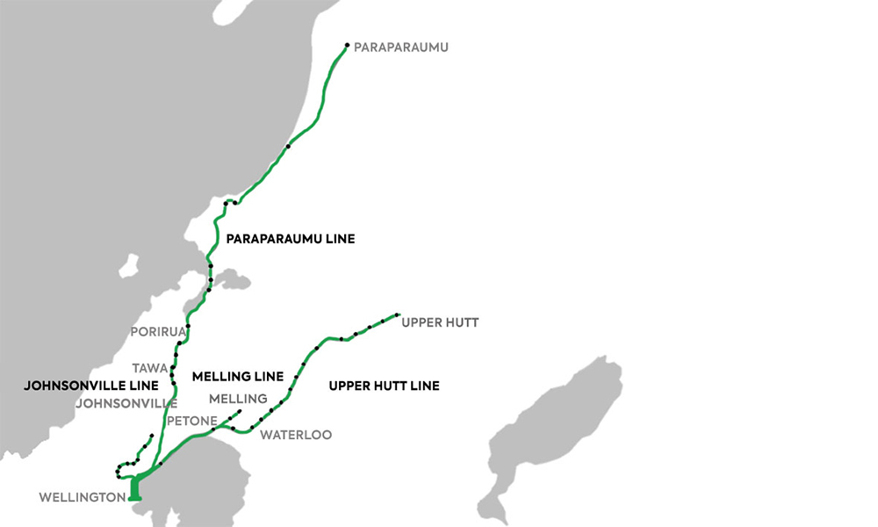
Wellington
TRAIN
Way to Go Train Commuter Network
PANEL ID: WAYTOGO
Physical Size:
Animation:
75"LCD
Yes
Ad Duration:
Pixel Size:
Operating Hours:
6 seconds
2160 x 3840
0400-2459
Advertisers who want to optimise their reach to the Greater Wellington population via outdoor, need to use the Way to Go Network. More people travel into the Wellington CBD and home each day on trains, than any other mode of Public Transport. The Way to Go Network comprises 47x premium 4K LCD screens located on the busiest stations; Wellington, Petone, Waterloo, Upper Hutt, Tawa, Porirua, Paraparaumu, and Johnsonville. The audience composition of Wellington train commuters is: 54% are male, 62% are 25-54 year olds, 78% use the train to get to work and 63% travel every weekday.

