Slide 1
Supervising Case Management
Developed and facilitated by
Grace Leotta
Affirm
Organizational Development and Training

Slide 2
Training Program: Learning Outcomes
By the end of the training workshop you will be able to:
Develop a framework for supervising case managers and case management.
Engage case managers in effective discussions about their work and facilitate reflective case management practice.
Use supervision to promote positive outcomes for individuals and families.
Use supervision techniques which promote and complement, solution-focused, strength-based and collaborative case management practice.
Build case managers’ capacity and enhance performance through effective supervision.
Reflect on your case management supervision practice and develop strategies to continue to enhance it and to build your confidence in case management supervision.

Slide 3
Training Program: Agenda Outline 9.30am-4.30pm
Day 1
Day 2
A brief overview of case management
What’s involved in supervising case managers and case management?
Meaningful case management supervision
Morning Tea
Engaging case managers in supervision
Developing case management supervision agreements
What do you talk about in case management supervision?
Lunch
What do you talk about in case management supervision - continued
Structuring case management supervision
Supporting, monitoring and reflecting on supervision practice
Facilitating reflection on case management practice
Giving constructive feedback
Recap
Facilitating reflection by asking questions
Morning Tea
Facilitating reflection by asking questions – continued
Supporting evidence based decision making
Responding to work issues, problem solving and enhance practice/performance
Lunch
Responding to work issues, problem solving and enhance practice/performance – continued
Group or team supervision
Afternoon Tea
Group or team supervision – continued
Your case management supervision practice
Review and evaluations

Slide 4
Why Case Management Supervision is Important
Empowered staff empower the people they serve.
Employees will not, in the long run, continue to give to others what they are not getting for themselves.
Anderson & Munchel, 2005
Adapted from Community Activators

Slide 5
An Overview of Case Management A Case Management ‘Journey’: Elements of Case Management
Community Outreach: creating pathways into services
Planning: working out what to do
Provision of Support and Linking: providing a good service and getting other services/supports involved
Coordination, Monitoring and Reviewing: making sure everything comes together and keeping a check on how everything is working
Transition: supporting the person/family to move to another service/ to independence
Closing and Evaluation: supporting the person/family to move on, acknowledging what has been gained, checking the how well the service was provided and working out what is needed for the future
Follow-up: providing ongoing support or checking on how the person/family is going
Advocacy and Helping to make other Services Appropriate/Friendly: supporting the person/family to have a voice and taking action to get the supports that are needed
Engagement and Assessment: making contact, getting to know the person/family and finding out what they need and want
Adapted from Raiff & Shore, 1993, Moore, Randall & Barton, 2009 and Families ACT, 2013

Slide 6
An Overview of Case Management: Approaches to Case Management

Slide 7
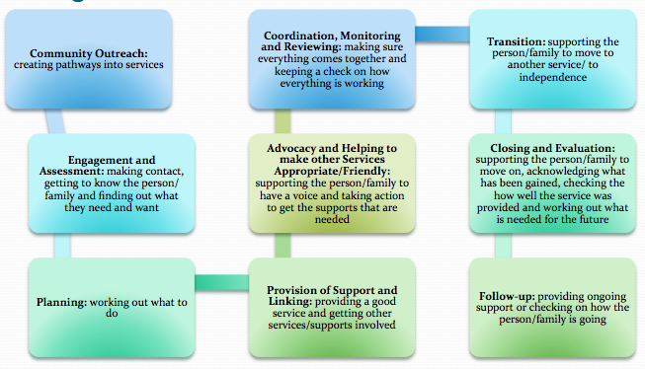
What model of supervision do you use in your service/program? – What do you say case management involves?
What is your service’s/program’s approach to case management? Such as strength based, trauma informed

Slide 8
Case Management Supervision as a Management, Development and Support Process

Slide 9
Case Management Supervision as a Management, Development and Support Process
Supervision
Enhancing accountability and quality
Collaborative problem solving, reflection and learning
Enhancing confidence, sense of competence and motivation
Addressing development and support needs

Slide 10
Meaningful Supervision
Person/family and worker focused
Regular
Uninterrupted
Individualised to the needs and style of the worker
Based on a trusting relationship
Planned
Models effective practice

Slide 11
Establishing a Collaborative Supervisory Relationship and Getting Started (Restarted) in Supervision
Engaging Staff
Developing a Supervision Agreement

Slide 12

Engaging case managers in supervision

Slide 13
Engaging Staff in Supervision
Developing a
positive
and trusting
relationship
based on
mutual respect
Explain supervision
Discuss past experience of supervision
Understand the staff member’s needs, learning and communication style and motivations (what is important to the person)
Spend time relationship building.

Slide 14
Developing a Case Management Supervision Agreement
A Supervision Agreement:
…a clear statement
made by both the
supervisor and the
worker at the beginning
of the supervision
process, following clear
guidelines from the
organisation about the
purpose of supervision.
Adapted from Morrison, 1993

Slide 15
A Supervision Agreement can include:
Expectations, roles and responsibilities of both supervisor and worker.
Agency requirements of the worker.
Development and support goals.
The structure of supervision, including:
  How often supervision sessions/meetings will be held
  Length of the sessions
  Location of sessions
  Recording of sessions
  The way the agenda of sessions will be set
  The possible content of the sessions.
Adapted from Morrison, 1993 and 2005

Slide 16
Establishing Supervision Goals
What are supervision goals based on?
The program’s/team’s operational plan
The case manager’s work plan
Learning and development needs and goals identified by the case manager and/or the supervisor or team
Results of a performance appraisal
The case manager’s career goals.

Slide 17
Agreements and Role Clarity
Developing a supervision agreement involves clarifying the role of the supervisor, in the same way the worker clarifies his/her role with the person/family (‘client’)
Role clarity
Role security
Emotional Competence and Empathy
Observation and Assessment
Partnership and Power
Planning
Coaching
Adapted from Morrison, 2005, Gibbs, Dwyer & Vivekananda, 2009 and Morrison & Wonnacott, 2010

Slide 18
What do you talk about in Case Management Supervision? - A Model of Case Management Supervision
The supervision process involves two interlocking systems
The person/family (‘client’)/case manager context
The case manager/supervisor context
Based on Hawkins & Shohet, 2006

Slide 19
What do we focus on in Case Management Supervision?
Wider context in which work happens
Supervisor focusing on own process
Supervisory relationship
Focus on the case manager
Process and strategies used by the case manager
Focus on the person/family and what and how they present
Focus on relationship between the person/family and the case manager
Adapted from Hawkins & Shohet, 2006

Slide 20
Using the model in supervision

Slide 21

Structuring Supervision
Before the supervision session
During the supervision session
After the supervision session

Slide 22
A Person Centred Supervision Process
1. Opening round
2. Agenda development
3. Items for information
4. Items for discussion
5. Agree to action
6. Closing/appreciation round
Adapted from Stirk & Sanderson, 2012 and Sanderson, 2006

Slide 23
Supporting, Monitoring and Reflecting on Case Management Practice
Person/family centred and collaborative practice tasks
Community Outreach
Planning
Provision of Support and Linking
Coordination, Monitoring and Reviewing
Transition
Closing and Evaluation
Follow-up
Advocacy and Helping to make other Services Appropriate/Friendly
Engagement and Assessment
Adapted from Raiff & Shore, 1993, Moore, Randall & Barton, 2009 and Families ACT, 2013

Slide 24
Case Management Standards
Guiding Principles
Case management facilitates the personal development of Clients
Case management advocates for Client rights
Case management is purposeful
Case management promotes sustainable solutions
Effective communication underpins case management.
National Standards of Practice for Case Management The Case Management Society of Australia (CMSA), 2013

Slide 25
Case Management Standards
Case Standards of Practice
Case Identification(screening) and Assessment
Planning
Monitoring
Evaluation and Outcomes
National Standards of Practice for Case Management, Case Management Society of Australia (CMSA), 2013

Slide 26
How do you Discuss and Address Issues in Supervision? Supervision Techniques
Some Techniques to Use in Supervision
One to one teaching/individualised instruction | Role play/rehearsal
Brainstorming | Facilitating reflection
Feedback | Problem solving
Modelling | Coaching
‘Case’ review | Passing on own knowledge and skills
Can be used in workload planning, ‘case’ reviews general discussion about work and responses to it, and the development and monitoring of projects.
Some of this is adapted from Salus, 2004

Slide 27

Facilitating Reflection on Case Management Practice

Slide 28
Facilitating Reflection on Case Management Practice: Key Techniques to Support Reflection
Giving Feedback
Asking Reflective Questions

Slide 29

Types of Feedback
Positive Feedback -
feedback to acknowledge and to
reinforce behaviour
Change Oriented
Feedback - feedback to change
behaviour or practice
Reflective Feedback –
feedback to encourage reflection on
and examination of behavior or
practice

Slide 30
Giving Constructive Feedback
In giving feedback it’s useful to think about the following:
What – do I want to achieve and therefore do I want to say?
How – do I say it?
Emotions – are there any emotional issues/barriers that may inhibit the exchange of feedback?
When – is the right time?
Where – is the right place?
Adapted from Carroll & Gilbert, 2007 cited in Gibbs, Dwyer & Vivekananda, 2009

Slide 31
Giving constructive feedback in supervision

Slide 32
Giving Constructive Feedback - continued
Positive Feedback
Be Immediate - talk about it as soon as it happens
Be Specific - give specific/concrete details of the behaviour
Focus on Observable Behaviour - what you can actually see/what has being reported to you
Make it personal - use ‘I’
Appreciate
Where appropriate give public acknowledgment.

Slide 33
Giving Constructive Feedback - continued
Change Oriented Feedback – as well as what is relevant for positive feedback
Choose the right time
Be Direct - get to the point
Be Concise – be brief
Be Objective – describe what you see without criticism, blame or interpretation
State the consequences of the inappropriate behaviour
Explore and listen to the person’s explanation or ‘side of the story’

Slide 34
Giving Constructive Feedback - Change Oriented Feedback - continued
Build on strengths and state what you want more of
Specify the desired behaviour in terms of unit/team/ professional expectations – what you want to see happen
Stay with the present rather than bring in issues from the past
Stay with the issue, avoid getting side tracked
Involve the person in the solution
Offer support

Slide 35
Giving Constructive Feedback - Change Oriented Feedback - continued
Ask for commitment to a specific action
State that you will follow up.
Where appropriate:
Ask the person to consider another perspective or course of action
Ask the person to consider another person’s feelings.

Slide 36
Positive Feedback | Change-Oriented Feedback
Feedback on a Behaviour, Incident or Event
For example, “… an excellent report…” | For example, “Not attending the last two case review meetings…”
Feedback on a Pattern of Behaviour or Development
For example, “I’m impressed with your work with families in the past three months…” | “I have noticed some tension between you and a couple of other team members in the past two months…”

Slide 37

What’s your style?

Slide 38
How Adults Learn: Learning Styles
Experience
Doing/ having an experience
Activist: immerse themselves in the experience
Reflection
Feelings about/responses to what happened
Reflector: stand back and observe
Analysis
Understanding the meaning/learning from the experience
Theorist: think through issues in a logical way
Action
Planning/trying out what has been learned
Pragmatist: put ideas and techniques into practice
Based on Kolb, 1984 and Honey & Mumford, 1982

Slide 39
How Adults Learn: Reflective Questions
Experience
Doing/ having an experience
What happened?
Reflection
Feelings about what happened
How did you feel?
Analysis
Understanding the meaning/learning from the experience
Why do you think that happened?
Action
Planning/trying out what has been learned
What will you do next?
Kolb, 1984

Slide 40
Part 1: Developing reflective questions
Part 2: Asking reflective questions

Slide 41
More Approaches to Facilitating Reflection
Critical Incident Reflection
Solution Focused Techniques
Person Centred Thinking
Appreciative Inquiry

Slide 42
Critical Incident Reflection
A Critical Incident
An incident that is significant or important (for professional learning)
An incident from which the person wants to learn
It does not have to be an emergency or crisis

Slide 43

Questions to Facilitate Critical Reflection
What happened?
What did you do?
Where were you coming from?
  What were you thinking would happen? What made you think that?
  What did you take for granted?
How did you react? What were you feeling? What were you thinking?
How did other people react?

Slide 44
Questions to Facilitate Critical Reflection - continued
How else could you have reacted?
How else could other people involved react? Where might they have been coming from?
What did it mean to you? What was important to you about this?
Where are you now? What is important for you now?
Where might you go with this?
From Fook & Gardner, 2007

Slide 45
Solution Focused Techniques
‘Solution focus’ is about
looking for solutions rather
than dwelling on problems.
It makes the assumption
that the worker has the
answers within her or
himself.
Adapted from Fowler, Fenton & Riley, 2007

Slide 46
Solution Focused Techniques - continued
1. Assume Competence
What’s something that went better than expected?
2. Determine a Desired Future/Set Achievable Goals
What would be happening if things were different or better?
3. Look at when things are Going Well/Exceptions to the Problem
What are the good things that are happening?
4. Identify Strengths and Resources
What helped you to achieve that?
5. Using Scaling to Set Goals and Measure Progress
On a scale of 0 to 10 where 10 is the way you want things to be and 0 is the worst things have been where would you say you are right now?
Some of this is adapted from Fowler, Fenton, & Riley, 2007 and Morrison, 2005

Slide 47
Appreciative Inquiry
Appreciative Inquiry is a strength based capacity building approach to dialogue to generate new ideas and build relationships. It involves asking unconditional positive questions.
1. Discovery appreciate what is
What has been a high point of the last week?
2. Dream
imagine what might be
What do you hope for?
3. Design
determine what should be
What do you need to do to make this happen?
4. Deliver
create what will be
What will you do next?
Whitney & Trosten-Bloom, 2003

Slide 48


Person Centred Thinking: Working/Not Working
What’s Working (or working well)
What’s not Working (or working as well)
Concepts from Sanderson

Slide 49
Person Centred Thinking - Four Plus Questions
What have we tried?
What have we learned?
What are we pleased about?
What are we concerned about?
Plus 1 - What will we do next?
Plus 2 - How will we share this with others?
Plus 3 - What are the implications for the service/support system?
Smull & Sanderson, 2005 and The Learning Community for Person Centred Practices, 2008

Slide 50
Supporting Evidence Based Decision Making: What is Evidence?
Evidence is any data or information that is relevant to use as a basis for decision making.
ACS, 2011

Slide 51

Using Internal Evidence to make Decisions
Some Tools

Slide 52
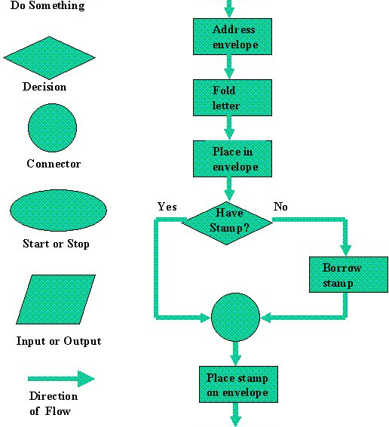
Some Tools
Flow chart: describes a process
Example of use: Describe the process from entering to exiting a service (or part of that process) to identify problems such as delays, or opportunities to improve/streamline the process.

Slide 53
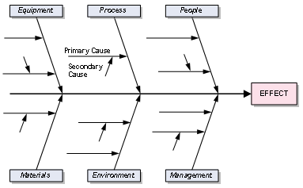
Some Tools
Cause and effect diagram (fishbone): Documents all the possible causes of an event
Example of use: Identify all the possible issues that may have led to a critical incident.

Slide 54

Some Tools
Journal/diary: records or logs activities and/or responses
Example of use: A reflective journal of actions and responses to highlight learnings; a diary of when/how often an activity was undertaken.

Slide 55

Some Tools
‘Case study’: A ‘story’ about an individual/group, behaviour, interactions, action/set of actions/process
Example of use: Discussion of a story of work with an individual/family to highlight actions and their results and to gain feedback or develop new strategies.

Slide 56
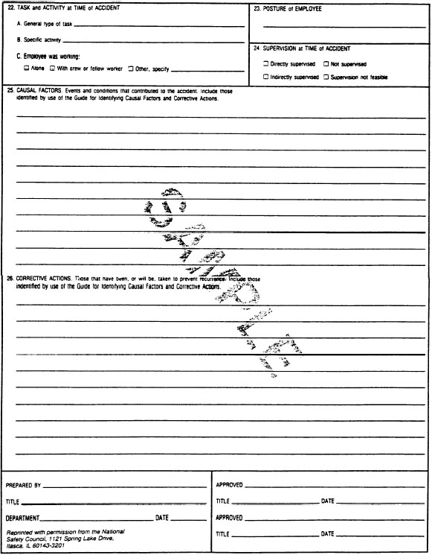
Some Tools
Critical incident analysis: Analysis of a critical incident in order to describe and learn from it (such as factors which impacted or triggered that incident or determine what was done during and after the incident); a critical incident may be a problem situation or a positive incident which was an exception to the problem or an example of a positive response.
Example of use: An analysis of an innovative response to a challenging situation.

Slide 57
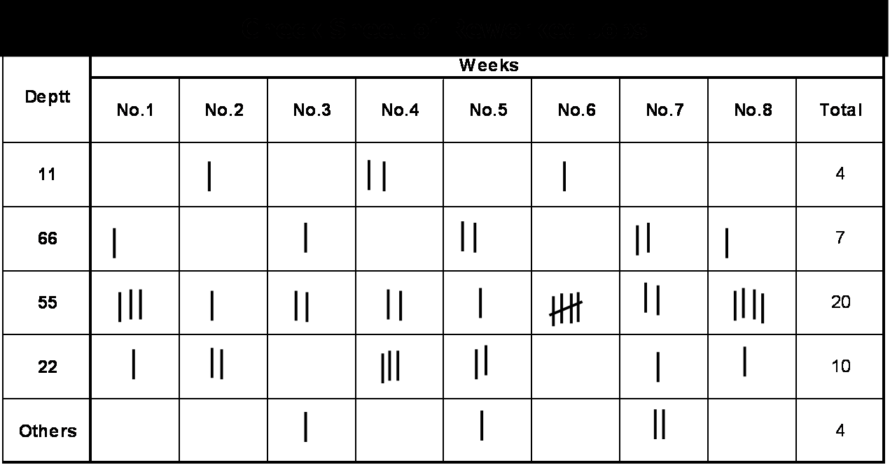
Some Tools
Check sheet: collects information on how often events occur
Example of use: Collect information on how often particular incidents, like delays in responding to enquiries occur.

Slide 58
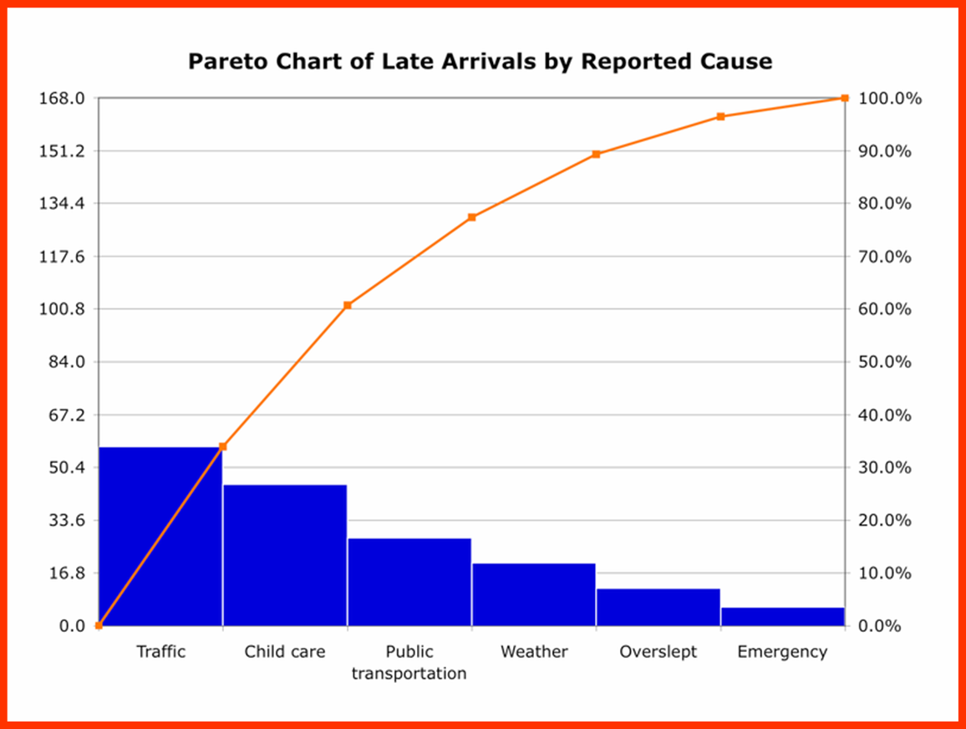
Some Tools
Pareto Chart: highlights the most important factors among a range of them
Example of use: Identify which factors contribute most to service re-entry.

Slide 59
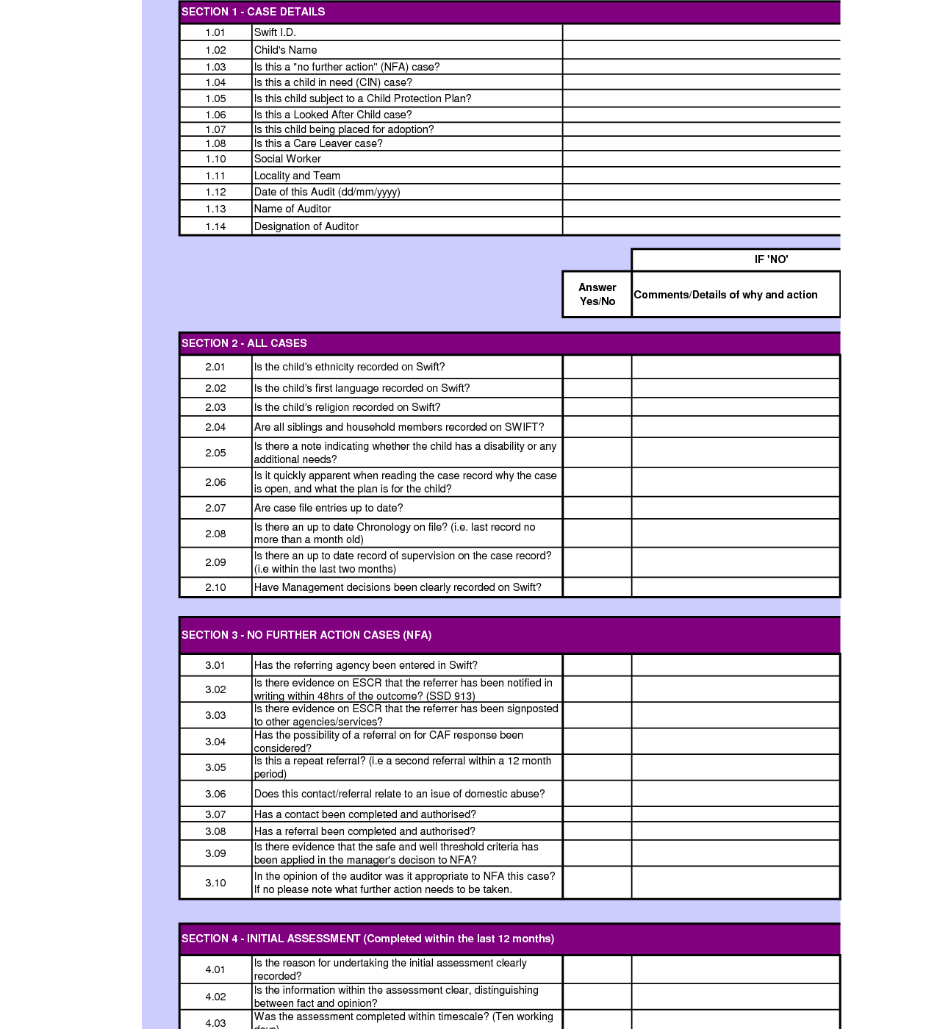
Some Tools
File/document/data audit: checks on the quality and accuracy of information collected and compliance with policies, procedures and legislation
Example of use: Check accuracy of client information, case plan and notes.

Slide 60

Using ‘Case File’ Audits
What do we want to know from Conducting ‘Case File’ Audits?

Slide 61

Using ‘Case File’ Audits as a Basis for Reflection
How can you use the preparation and/or results of the case file audit to facilitate reflection on practice?

Slide 62
Responding to Work Issues, Problem Solving and Enhancing Practice/Performance

Slide 63
Using feedback and reflective questions to respond to work issues, problem solve and enhance practice/performance
  Matilde - “we shouldn’t impose our structure on them”
  Rory – first job
  Leila - team members “have it easy”

Slide 64
Building Capacity: Strengths Based Planning
Story, Issues, Feelings What’s happening? I’ve noticed…
Picture of the Future | Strengths, Resources and Exceptions | Other Resources | What seems Achievable | Steps to Take
What would be happening if things were different or better? | What are the good things that are happening or exceptions to the problem? | What other resources might be useful? | Of all the possible actions, which ones feel achievable now? | What are the very first things that need to be done?
Adapted from St Luke’s Column Approach, Beilharz, 2002 and McCashen, 2005

Slide 65

Group or Team Supervision
Group supervision is a
negotiated process whereby
members come together in
an agreed format to reflect
on their work by pooling
their skills, experience and
knowledge in order to
improve both individual
and group capacities.
Morrison, 2001 in Morrison, 2005

Slide 66
Group Supervision Guidelines
Purpose
Membership
Expectations of group members
Group supervision agreement
  Group agreements
  Meeting frequency, times, etc.
  Facilitation
  Agenda preparation
  Processes
  Recording of sessions
  Review
Agenda
Review

Slide 67

Our Vision for Case Management Supervision
Success means:
  If there is quality, consistent case management supervision what is it like?
We work to achieve this by:
  What specifically will we do?
We measure this by:
  How will we know?
Case Management Supervision One Page Strategy
Adapted from Helen Sanderson concepts

Slide 68
Where to
Next?

