Slide 1
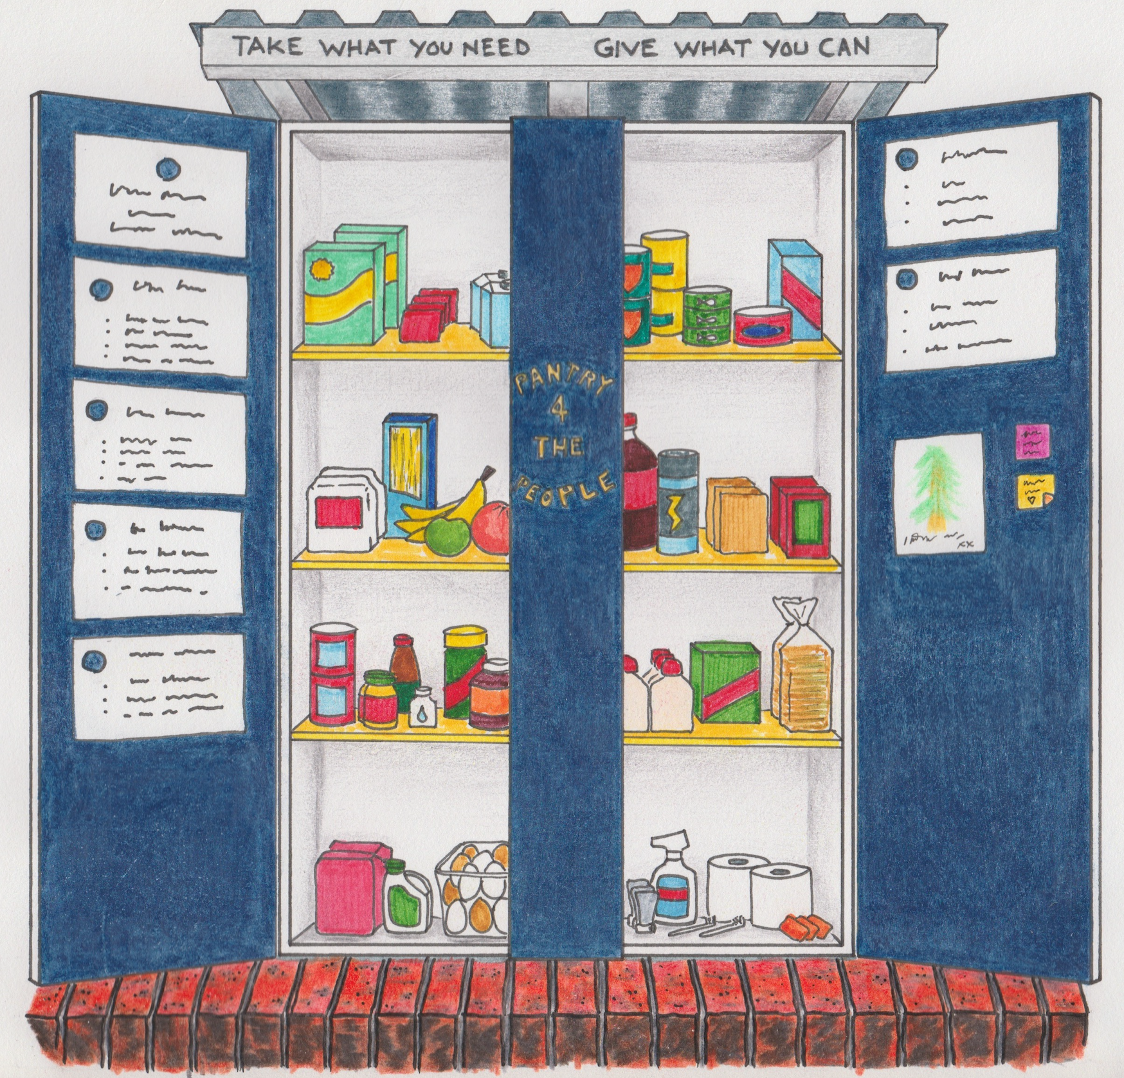
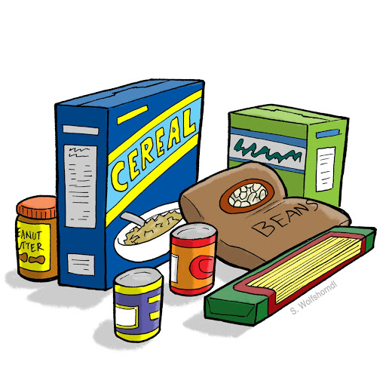
Community Giving Project
We all know how important our community is to our overall feeling of wellbeing and we are giving back by supporting Pantry 4 the People located at 1555 Botany Rd, Botany
We gratefully welcome you to donate pantry items here, examples listed below and follow @pantry4thepeople_Sydney on Instagram to see the impact that we having locally for those in need
Pantry Items
Toiletries
Pasta & pasta sauce
Canned food (baked beans, tuna etc)
Noodles & rice
Instant meals (non-refrigerated)
Breakfast cereal
Baby food
Snacks & biscuits
Pet food
Sanitary pads
Deodorant
Soap & hand wash
Nappies
Toothpaste & brushes
Shampoo & conditioner
Razors & shaving cream

