Slide 1


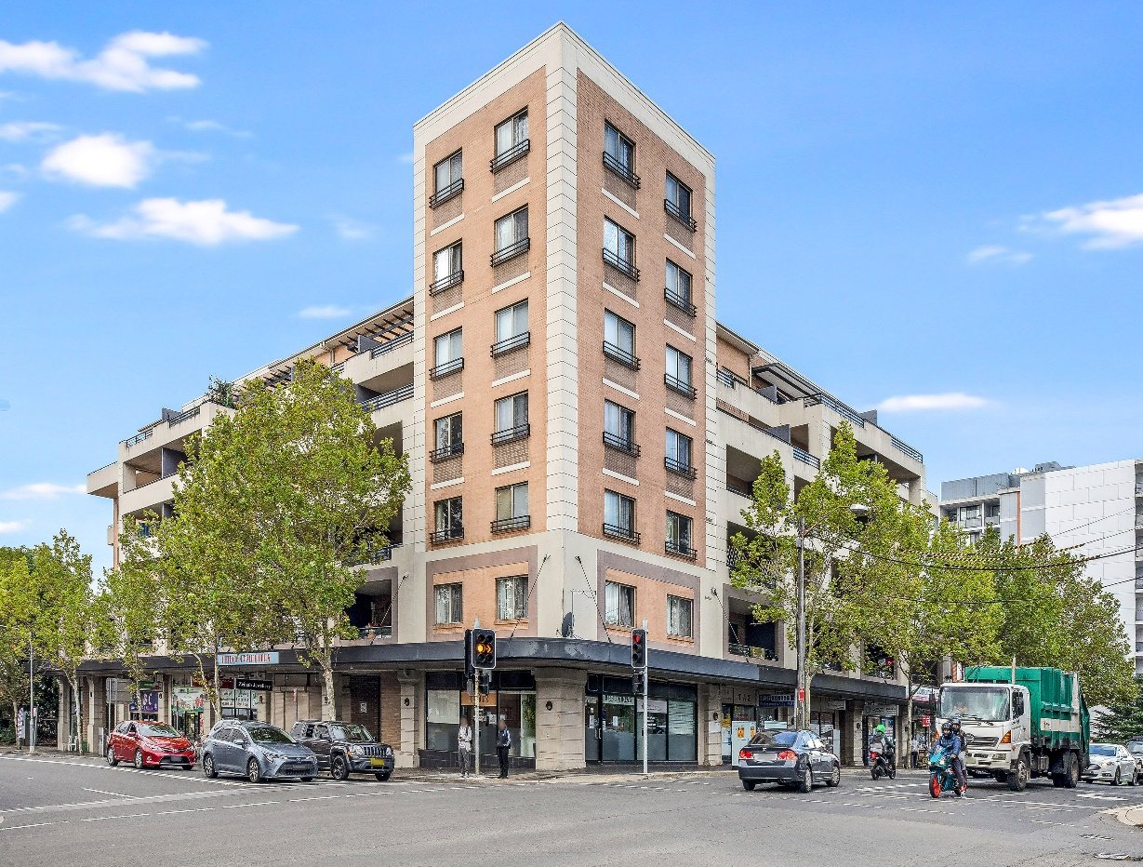
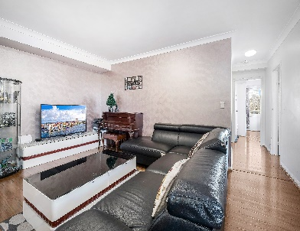
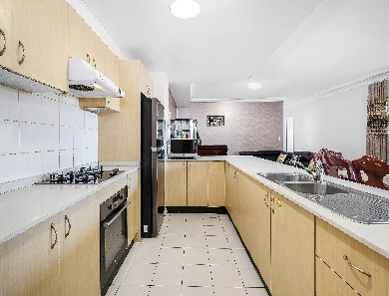
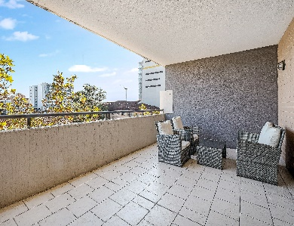




New Listing
40/45 RAWSON ST, AUBURN
$629,000
3
2
FOR SALE
2
3 BEDROOM BEAUTY
3 Large Bedrooms
2 Modern Bathrooms
3 Toilets
Open kitchen with gas cooking
Spacious lounge & dining
Entertaining terrace with views
Internal laundry
Double Garage
Moments to station, shops, schools.
Inspection:
Sat: 12.00-12.30pm
Total Size:
Council#:
Water#:
Strata#:
App 165 sqm
App $293pq
App $155pq
App$1,295pq
PHOTO
Jessie Liu
0404-893-418
# - All reasonable care is taken to ensure information contained herein are correct and accurate. However, we cannot guarantees their accuracy and you should rely on your own enquires
112 South Pde Auburn 2144
www.waterscarpenter.com.au
We put you first
Auburn: 9649 0238

